Slide 1
Time | Agenda
11.35 - 11.45 | Ian Harrison - Managing Director, Rushmoor Borough Council Update on the 12 Councils’ Joint Proposal for LGR and Devolution
11.45 - 11.55 | Donna Bone - CEO, RVS Update Hants CC’s Proposal for LGR
11.55 - 12.05 | Mike Grange - Trustee and Operations Co-Ordinator Silent Storms
12.05 - 12.15 | Stan Gibson - Trustee Farnborough Welcome Club
12.15 - 12.20 | Member updates
12.20 - 12.30 | Summary & date of next meeting

Slide 2


Slide 3
RVS Devolution & LGR Update 24th September 2025

Slide 4
Agenda
Item
Devolution & LGR Recap
LGR Process To Date
Proposal
Implementation and next steps
Hampshire County Council Proposal
Community Governance Review
Q&A

Slide 5
Devolution – what is it?
The transfer of central government powers to a more local level
Transport
Economic development
Water & flood defence etc
More extensive in Northern Ireland, Scotland & Wales – In UK Greater Manchester often quoted as successful example (Mayor Andy Burnham)
Strong desire from this government to devolve more to local authorities to allow greater freedom and flexibility to improve services

Slide 6
How will Devolution happen in Hampshire?
Hampshire and Solent selected to be part of the Devolution Priority Programme
Initial step create a Strategic Authority
These new authorities will be led by elected mayors and have responsibilities for strategic issues
Step 1 – Create a combined authority of two or more existing upper tier authorities
HCC, PCC, SCC, IoW
This stage will be complete later in 2025
Step 2 – Elect a Mayor to oversee the combined authority
Known as a “Mayoral Combined Authority” or “Strategic Authority”
Scheduled for May 2026
New powers devolved to this body

Slide 7
What responsibilities could an Elected Mayor have?
Local transport authority
Adult skills and employment
Strategic housing and planning
Environment and climate change
Economic development and research
Culture and heritage
Reforming and joining up public services
Police and crime commissioner
Fire and rescue authority
Health improvement & inequalities

Slide 8
Local Government Reorganisation
Government has made it clear it wishes to see the end of two-tier working in Local Government.
Two-tier is a term used to describe an area with district/borough councils and a county council
Each has different functions and responsibilities
Numerous examples of where there are inefficiencies between tiers
LGR will see the end of district and borough councils, county councils and small unitary councils.
In their place will be new ‘larger’ unitary councils – these new councils once ‘vested’ will replace those on the strategic authority which will then become a Mayoral County Combined Authority (MCCA).

Slide 9
LGR Process to date
Interim proposals were submitted on 21st March
Supported by all 15 Hampshire Authorities
Majority of Councils have continued to work together on detailed proposals supported by KPMG
Hampshire CC and East Hants are working together on alternative proposals (supported by PWC)
Gosport have withdrawn from the KPMG work but not pursuing their own proposals
IOW Council Outcome
Consultation/engagement activity took place over the summer to form part of proposals
Joint case to Government published 3rd September
Report and appendices available on Rushmoor website
Extraordinary Council 25th September
Submission to Government 26th September.

Slide 10


Proposal published
Group of 12 Councils Working with KPMG

Slide 11
Key objectives of the joint proposal
Show how we would;
Replace the outdated two-tier system with a single-tier model to improve efficiency, responsiveness, and financial sustainability.
Deliver locally tailored services that reflect community identity and needs.
Align governance with economic and population centres.
Support devolution through a balanced Mayoral County Combined Authority (MCCA).

Slide 12
The proposal outlines a bold vision to restructure local government in Hampshire and the Isle of Wight by:
Creating four new mainland unitary councils centered around Southampton, Portsmouth, Winchester, and Basingstoke.
Retaining the Isle of Wight Council as an independent unitary authority due to its unique geography and needs.

Slide 13
Joint Vision
“We will deliver high-quality, locally tailored services that focus on prevention and long-term sustainability. By building strong, people-centred communities and harnessing the strengths of our local economies, we will drive inclusive growth and create vibrant, resilient places where everyone can thrive.”

Slide 14
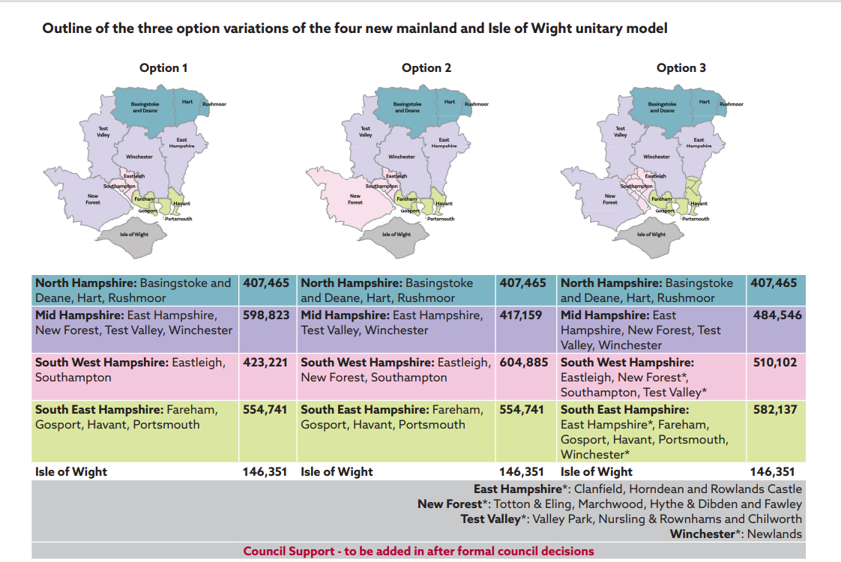
The Changes Proposed
4 new unitary councils
All options the same for Rushmoor - North Hampshire unitary council based on areas of Rushmoor, Hart & Basingstoke.
Outline of the three option variations of the four new mainland and Isle of Wight unitary model.

Slide 15
Proposal overview
Close enough to be local, big enough to stay strong
A shared vision for the future of local government that will deliver the best outcomes for the people of Hampshire and the Isle of Wight
Local identity: Each unitary reflects the unique and diverse geographies and communities within the county, allowing each part of Hampshire and the Isle of Wight to play to its strengths and recognise its residents unique needs.
Financial sustainability: Our model reduces duplication, achieves savings, and is large enough to be financially resilient with an average population of ~500,000 for thew new unitaries. All three variations payback in 2.3-3.1 years and deliver annual savings of between £63.9m and 91.8m.
Service quality: Services will be high quality, locally tailored, and innovate through a focus on prevention and transformation. Place-based, right-sized organisations have a proven track record of improving outcomes.
Economic growth: Each new unitary aligns with a distinct economic area, supporting targeted growth and strategic planning. Our model provides balanced voices and avoids dominance of a single council under an MCA.
Community engagement: Our proposed structure enables stronger local representation and neighbourhood empowerment through a place-based approach that provides communities with a voice.
Collaboration: Our proposal is the result of extensive joint working between 12 of the 15 councils in Hampshire and the Isle of Wight, public engagement and key stakeholders who understand local issues.
The Isle of Wight’s distinct island features and needs support its ongoing independence as an island unitary authority. Merging with mainland units would duplicate services without cost savings and reduce local accountability. The island remains financially stable and will collaborate with the new mainland unitaries.

Slide 16
How do you transfer responsibilities from one Council to another? (or from 15 Councils to 4)
Step 1 – Create a shadow authority
Covering the newly agreed areas
This work will be undertaken in 2026/27
Step 2 – New authority assumes control of services
Existing authorities are abolished
Elections to this authority in May 2027
In reality there will be very little noticeable change for residents to start with
Expected date April 2028

Slide 17
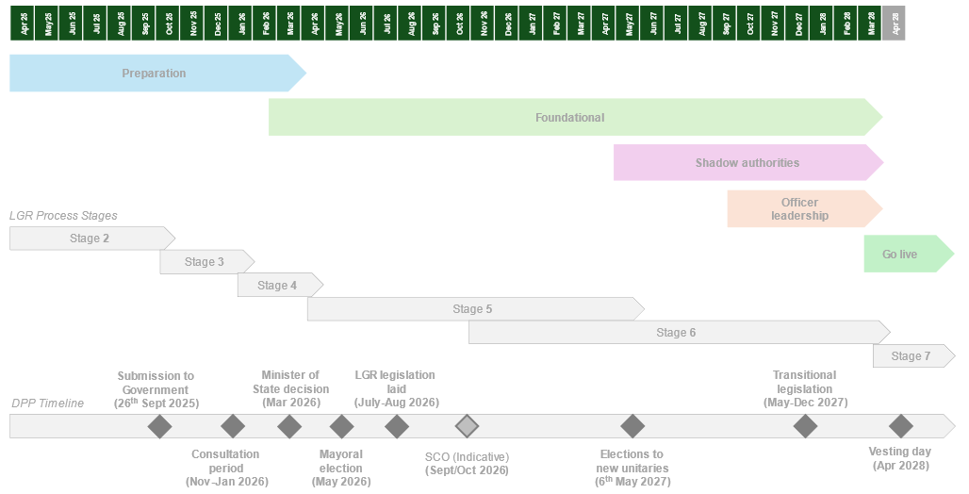
Implementation & Next Steps

Slide 18
Seven Stages to creating new local government arrangements
Inviting unitary proposals
Submission of formal unitary proposals
Statutory consultation
Decision to implement a proposal
Making secondary legislation – Structural Changes Order (SCO)
Transition period
New unitary authority goes live

Slide 19
LGR Timescales Summary
Area | Final Proposals | Decision (approx) | Shadow Council Election (approx) | Go Live (Vesting Day)
Surrey | May 2025 | Autumn 2025 | May 2026 | May 2027
DPP | 26 Sept 2025 | Early 2026 | May 2027 | May 2028
Non-DPP | 28 Nov 2025 | Spring 2026 | May 2027 | May 2028

Slide 20
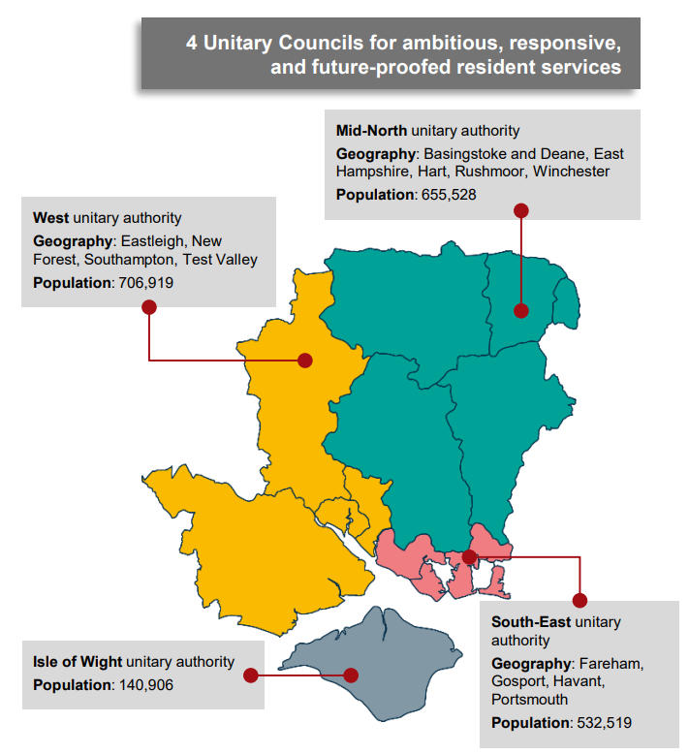
HCC – Proposal and report published
HCC proposal for a Simpler, Stronger, Secure future for
Hampshire and the Solent’s residents and partners
Next steps
The recommendation to submit the County Council’s proposal and business case to central Government will be debated by the Full Council before being considered by its Cabinet.
If approved, the County Council and East Hampshire District Council will submit it to central Government on 26 September. Other councils across the area will also submit their own ideas for change.

Slide 21
Community Governance Review

Slide 22
Community Governance Review
1st Consultation
The 1st stage CGR consultation had 400+ responses, consultation closed on 12th September.
Residents broadly supportive of new arrangements. Participants raised concerns about costs, governance integrity, and authority of new bodies.
Next Steps
Currently expecting to go ahead with second stage consultation subject to Council decision on 25th September.
The CGR report will set out the options for consultation with residents.
If approved, the 2nd stage consultation will run from 6 October to 28 November.
Council will be asked to make a final decision on the review outcomes before the end of January 2026.

Slide 23
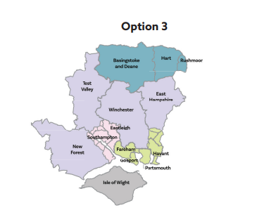
Q&A

Slide 24
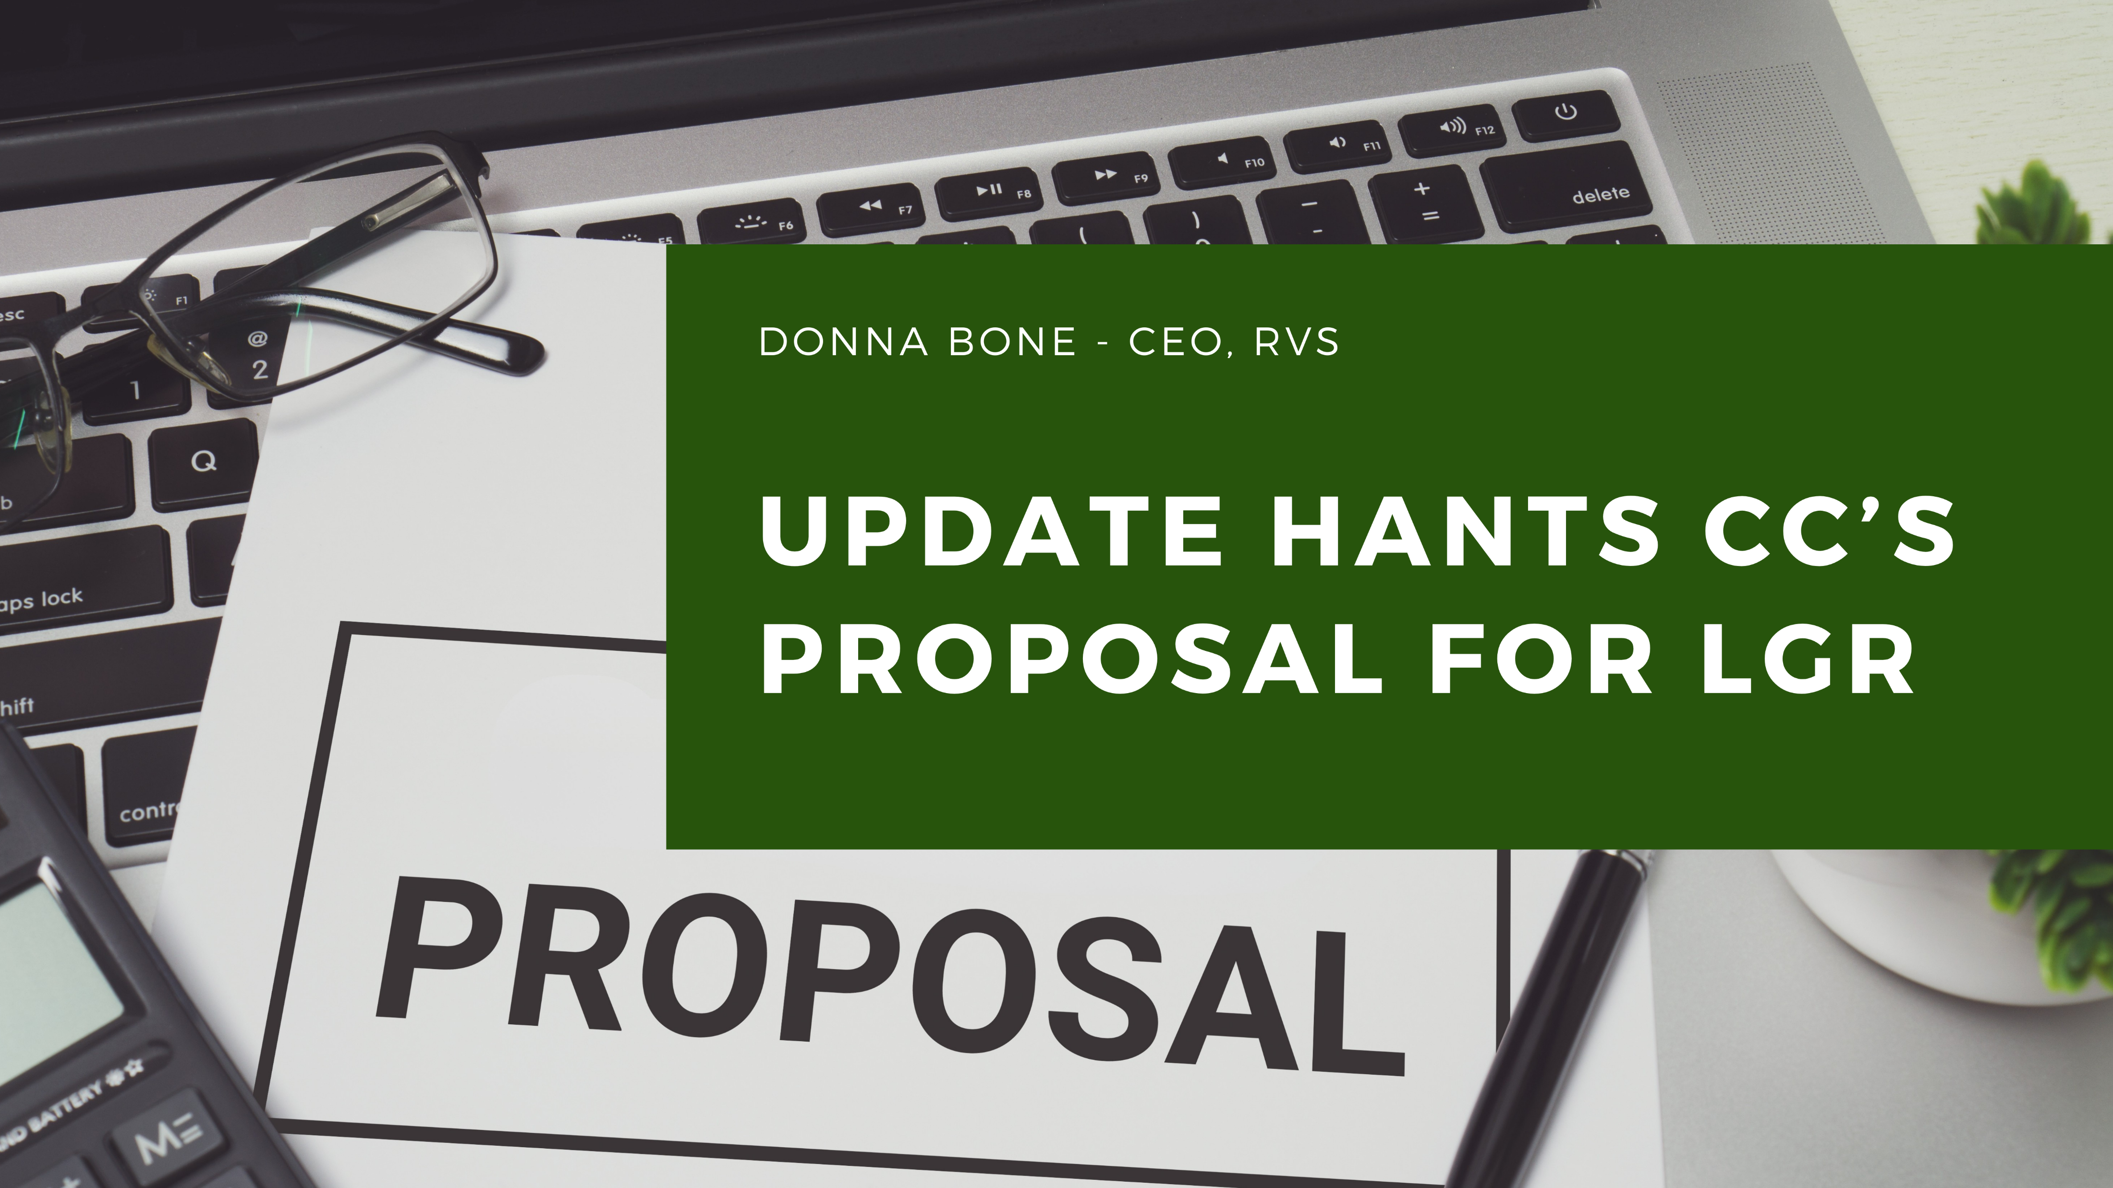
Notes:
Take out on and put hants cc on same line.

Slide 25



Slide 26
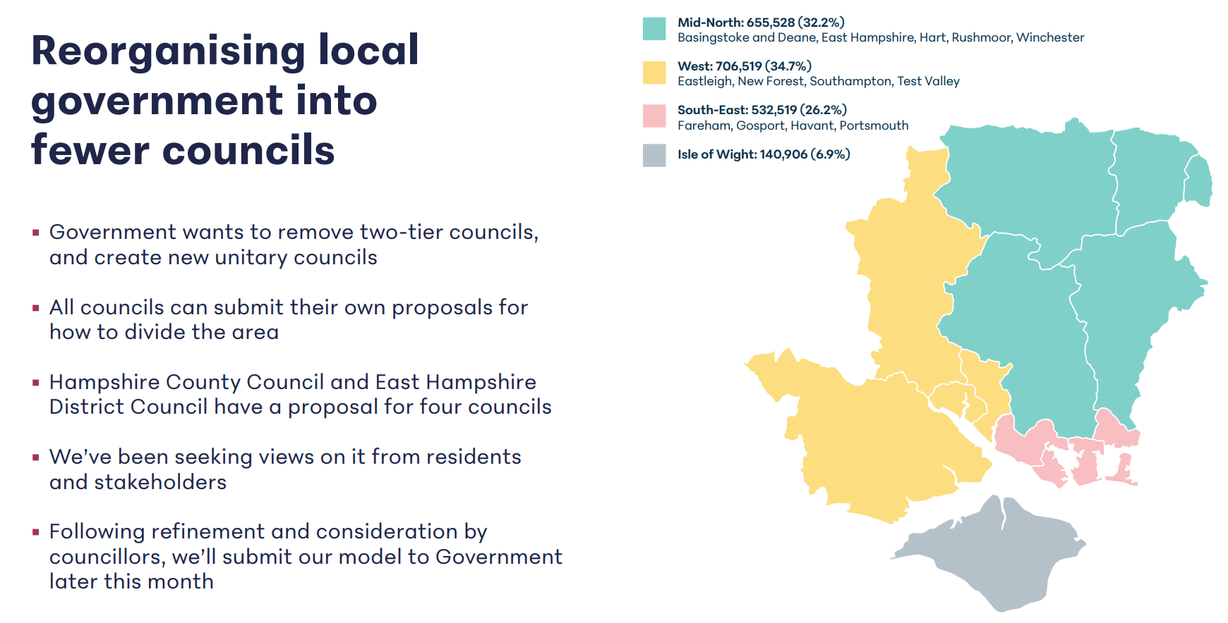

Slide 27
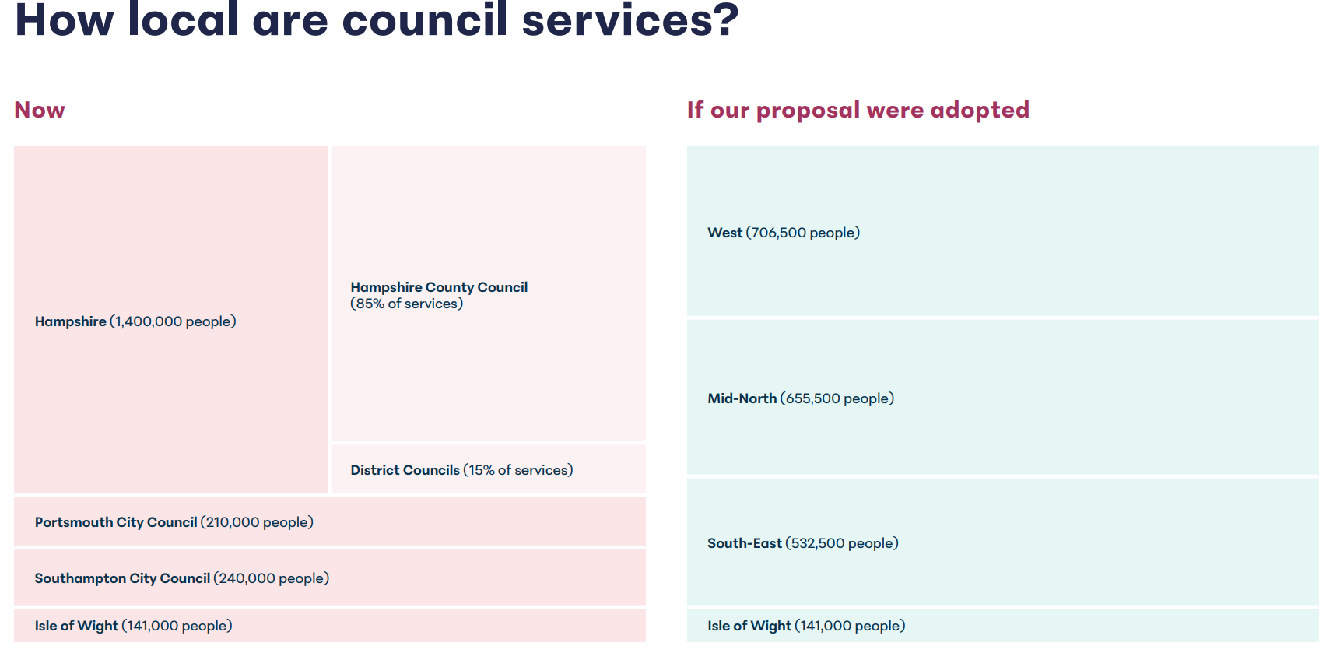

Slide 28
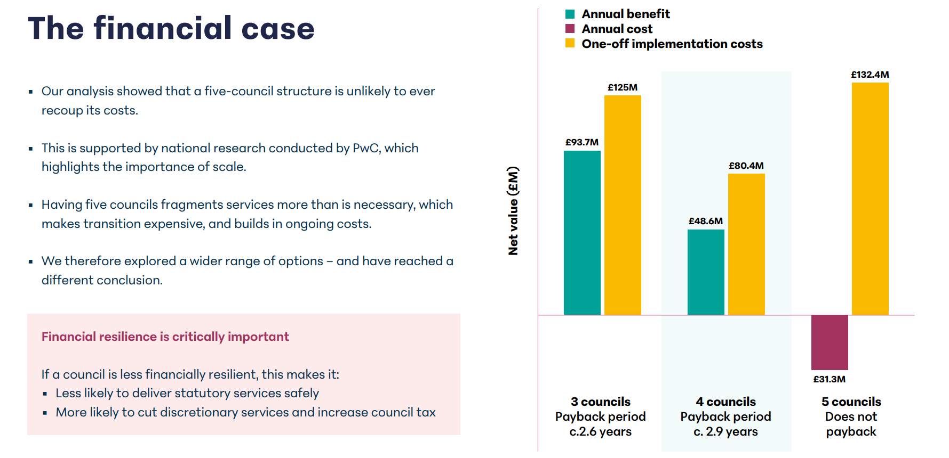

Slide 29
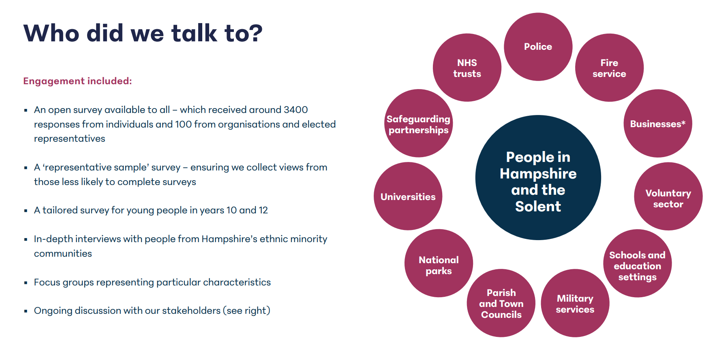

Slide 30
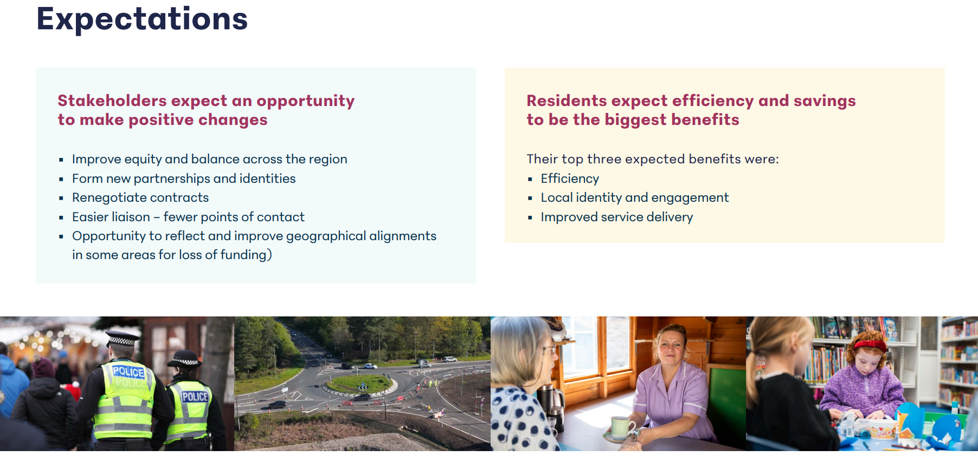

Slide 31
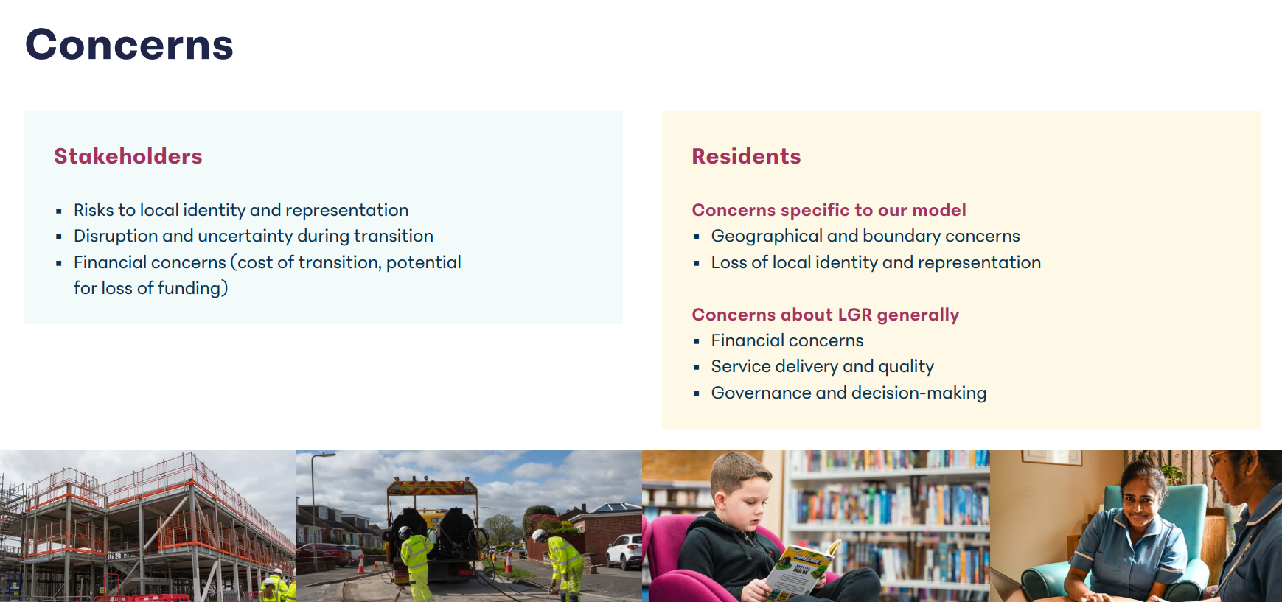

Slide 32
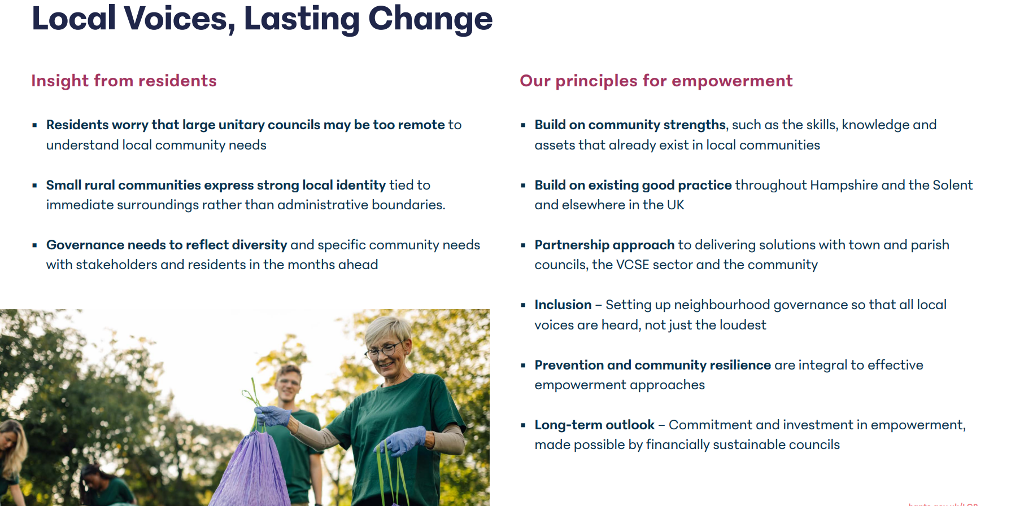

Slide 33
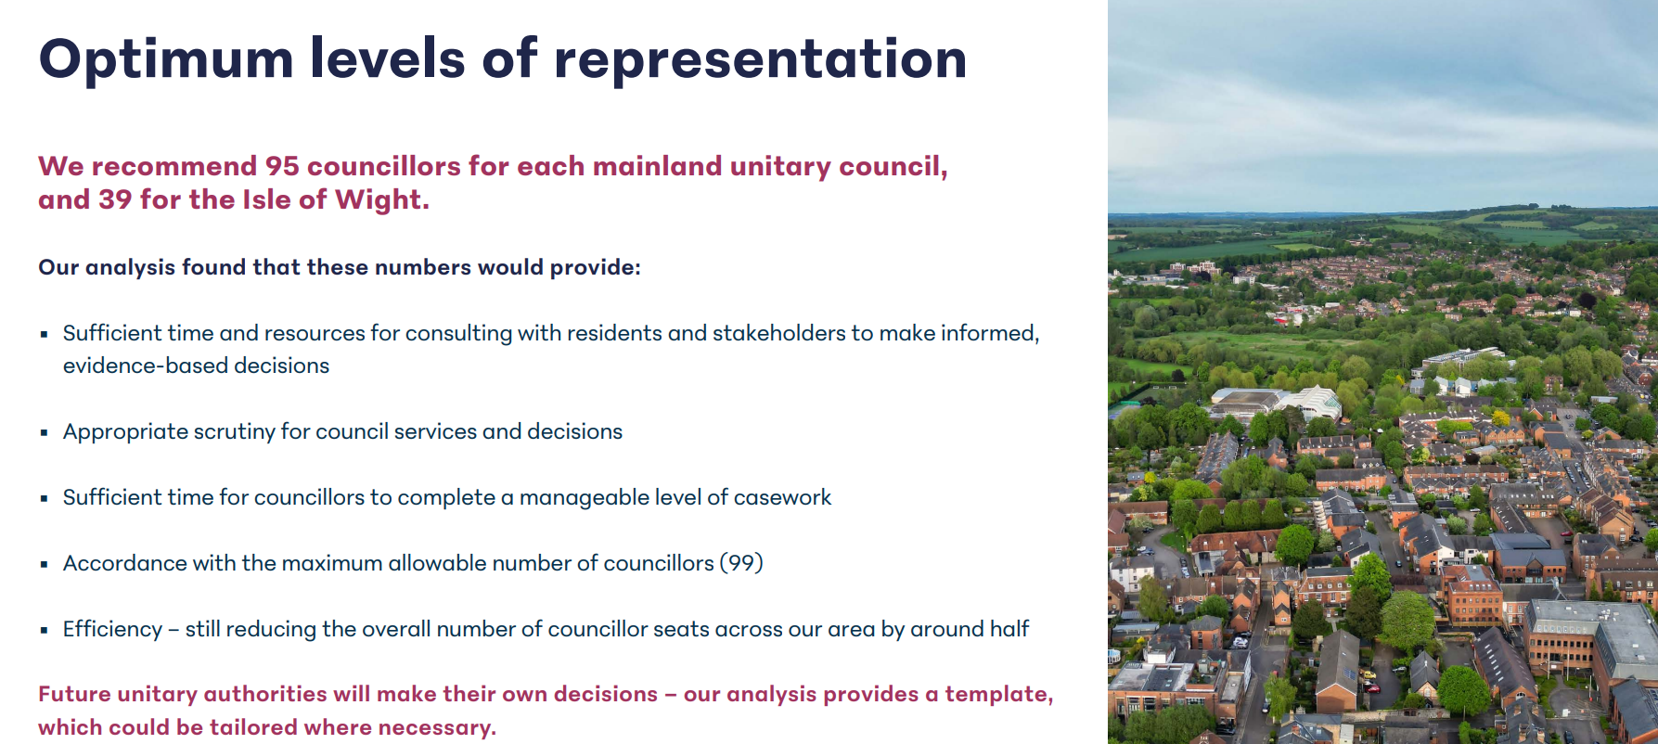

Slide 34
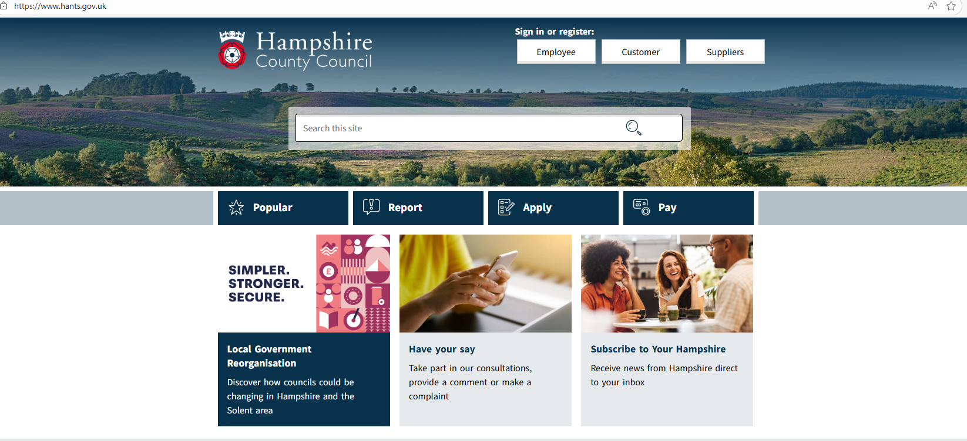

Slide 35

Volunteer Sector Forum
September 2025

Slide 36
Silent Storms - Who Are We?
A Community Focused men’s peer-to-peer support network
Built on honesty, trust, and lived experiences
A safe space for men to talk, share, and walk together
A movement that puts wellbeing, connection, and brotherhood first
Completely Non-Judgemental

Slide 37
Where have We Come From? What Have We Achieved?
Founding Members were part of Andys Man Club – Breaking away in October 2024 - Silent Storms was founded with one group, a handful of men and a shared belief – “Helping That One Man”
The first Silent Storms Group was held 28th October 2024 at the Enterprise Centre in Aldershot
Partnership was formed with “The Healing Hubs Charity” as an umbrella organisation in November 2024
We Launched our 3rd Venue at the GRNC on 05th April 2025
February 2025 Silent Storms partnered with “For Men To Talk” offering Bi-Weekly walks for Men Only – Supporting Mental Health through Walking and Talking.
We Opened our 2nd Venue in Fleet at the Harlington Centre on 17th March 2025

Slide 38
Where have We Come From? What Have We Achieved?
We Received our Official Charity Status 09th May 2025
July 2025, We Launched “Storm Striders” – Silent Storms own Walking & Activity Group – In doing so we came away from “For Men To Talk”
We Opened our 4th Venue at Farnborough Football Club 11th August 2025
September 2025 we Relocated to Fleet Town Football Club (We will no longer be use the Harlington Centre)
Not Forgetting the Launch of our Website and Multiple Social Media Channels & Groups

Slide 39
Summary of What We have Achieved in only 11 Months!!
4 Venues Launched
Launch of our Website and Multiple Social Media Channels & Groups
Walks Events and collaborations Launched
Recognition with Local Councillors, Media and The Community
Full Charity Incorporated Status – No Mean Feat in Itself
Strong Mentor Network !!

Slide 40
Some Fact’s
In total Across 4 Venues, we have run 92 Sessions (Not Including Walks)
From these sessions we have seen 937 Attendees of which 101 of those have attended for the 1st Time

Slide 41
With this Growth Comes the Need for Structure – This is how we see the organisation as of today
Paul Colins Co- Founder/Trustee
Jesse Lloyd – Co-Founder/Trustee
Mike Grange – Trustee/Operations Co-Ordinator
Andrew Garner – Group Lead Farnborough
Mike Davey – Group Lead Aldershot
Joanne Harper - Trustee
Dhan – Group Lead GRNC
John Williams – Group Lead Fleet
Stu Sambells - Mentor
John –Tiller Mentor
Darren Suddaby - Mentor
Steve Alman - Mentor
Anthony Gaines (Chess) - Mentor
Sean Chambers – Mentor
Colin Masters – Mentor

Slide 42
How Will We Fund Our Growth?
Donations – From members, their families and supporters who believe in us
Fundraising Activities – Sponsored events like Sky Dives, Challenges and community fundraising drives organised by our group leads, mentors, members and wider supporters.
Grant Applications – Where possible, we will apply for local funding, lottery or wellbeing grants to helps us grow and sustain groups.
Community Partnerships – Some of our costs are offset by partnerships with local footballs clubs, businesses and community organisations, who offer free use of facilities or provide sponsorship.
Every penny we raise goes straight back into running silent storms – ensuring our groups remain a safe, welcoming and supportive space for anyone who needs them.

Slide 43

Notes:
Lunch Club – Make it look nicer

Slide 44


Slide 45


Providing youth services to the local
community across the Yateley area
https://vision4youth.org.uk
NEW!
We’ve expanded our 1:1 service Youth Social Prescribing into Rushmoor – supporting young people across the borough

Slide 46

Up next:
Hart AGM, followed by Hart & Rushmoor VSF on 8th December 10 – 12.30 at Hart Civic Offices

