Slide 1
Rushmoor Borough Council Grants and Lottery Meet the Funders 2021
Alison Nicholls
Grants & Administrative Officer

Slide 2
Grants and Lottery
Ward grant scheme
Community grants
Farnborough airport community environmental fund
Rushmoor Community Lottery
Notes:
I’m going to give you a brief outline of the grant funds that I administer and the Rushmoor Community Lottery, starting with the Ward grant scheme.

Slide 3
Ward grant scheme
Each of the 13 wards has £3,000 to support projects or activities that benefit communities within the ward
Applications must be for specific projects or events and cannot be used towards general running costs of the organisation
Projects may cover or benefit more than one ward
Minimum grant is £50
www.rushmoor.gov.uk/wardgrants
Notes:
Within Rushmoor there are 13 wards, each with 3 councillors
Each ward has £3,000 a year to award to community groups for specific projects or events which benefit the ward
Grants can be applied for which benefit more than one ward
As with all our grants, funding cannot be awarded retrospectively for projects that have already happened

Slide 4
Criteria
Projects must meet the Council’s key priorities - place, people, partnerships
And match at least one of these criteria:
Physical or mental health
Economic hardship (including increased debt)
Young people (opportunities and aspirations)
Connecting communities (engagement, digital divide and loneliness)
Climate change
Notes:
This year we’ve introduced the some criteria which reflect the priorities of the Council’s Supporting Communities Strategy and Climate Change action plan
These criteria are quite loose, so most projects will fit into at least one of them

Slide 5
Examples of projects
Community defibrillators
Equipment for community groups/sports clubs
Physical or mental health events for residents e.g. wellbeing walks, cycle rides, ‘give it a try’ sport events
Events to reduce isolation and loneliness
Events to engage and inspire young people
Materials for environmental or recycling projects e.g. bird/bat boxes, bug hotels, planting schemes, water butts
Notes:
Here are some examples of the types of projects which the scheme will support
Community defibrillators must be accessible to the whole community not just the organisation which looks after it – e.g. there’s one outside Parity and another one at Farnborough North Station.

Slide 6
The Process
Online applications can be made until the end of February 2022 or until funding has been allocated
At least two of the ward councillors must support each award
Decisions will be made monthly by ward councillors
Six months to complete the project
Payment made in arrears
A feedback report is completed
Notes:
Each award must be supported by at least two of the ward councillors – I would recommend you contact to see if your project is something they will support before you make the application
Groups who’ve received funding in previous years need to have completed previously funded projects before applying for another grant
On the website you can find full details about the fund, what has been awarded funding in the past, how much is left in each wards’ pot, and links to the councillors contact details

Slide 7
Community grants
Grants available: £50 - £1,500
Applications from voluntary/community groups for one-off projects, events or equipment
Decisions made by the portfolio holder for Democracy, Strategy & Partnerships
www.rushmoor.gov.uk/comunitygrants
Notes:
Moving on to Community Grants
This is a small pot money, with only a handful of grants made each year
Not-for-profit groups can apply for up to £1,500, again for events or equipment
As for all our grants, your group needs to have a constitution and it’s own bank account
Full details about the fund are on the website along with awards made over the last few years

Slide 8
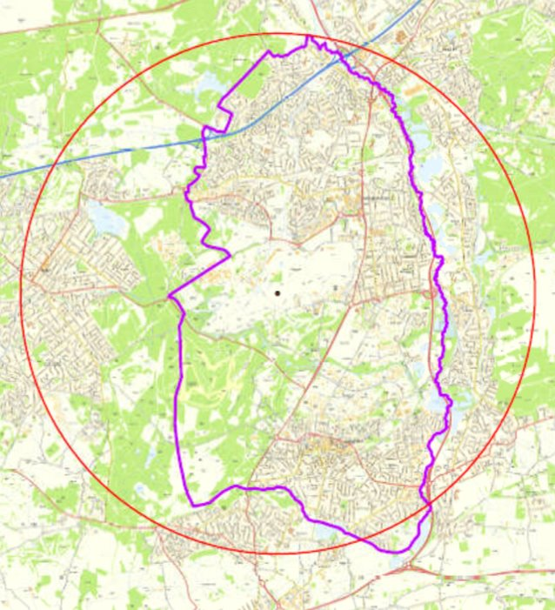
Farnborough airport community environmental fund
The airport pays a levy of £2 or £5 for every take-off or landing
Community groups located within 3 miles of the centre of the airport can apply for environmental projects
Received £40,535 for this year
£29,000 available for allocation
https://www.rushmoor.gov.uk/airportfund
Notes:
Next is the Farnborough airport community environmental fund
The fund is financed by the airport paying for every take-off and landing, the amount depending on the size of the plane
The area the fund covers is in the red circle and includes Rushmoor, parts of Hart, Surrey Heath and Waverley
Each January we receive payment for the previous year’s movements. This year’s amount was smaller than normal due to Covid. In comparison, last year the fund received over £64,000
Full details about the fund are on the website along with awards made over the last few years

Slide 9

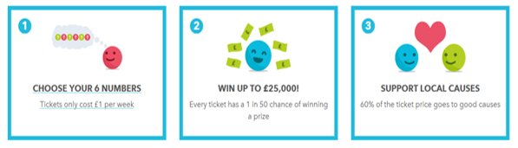
Rushmoor Community Lottery
50p from each ticket goes to the chosen good cause
10p from each ticket goes into the Community Fund
Notes:
And finally, we have the Rushmoor Community Lottery, which many of your groups are already signed up to as good causes.
A brief background for those who this is new to:
Four years ago, the council set up the lottery to help community groups raise extra funds
Groups sign up as a good cause and receive 50p from every ticket bought supporting their cause
Tickets cost £1 and can be bought online or by phone
Players can support a specific cause or the Community Fund​ (which we administer & I’ll tell a little bit more about in a minute)
As I’ve said, 50p goes to the supported cause and a further 10p goes to the Community Fund
The other 40p is for prizes, admin & VAT
Players choose 6 numbers​ and
Can win prizes up to £25k for matching numbers​
So, how are we doing?

Slide 10
4 years and 214 draws on . . . .
204,046 tickets sold
£122,723 raised for good causes
122 good causes
4,295 prize winners
Two winners of £2,000
43 winners of £250
379 winners of £25
3,871 sets of three extra tickets won
28 Community Fund grants awarded
Notes:
We’ve raised an amazing £122,700 for good causes in Rushmoor
Have 122 good causes and
Have awarded 28 grants from the Community Fund
Our top earning good cause has raised over £8,800 (Farnborough Rugby club) – this shows what can be done with constantly reminding your supporters about the lottery and what you’ll use it for
Check out the website to see what all the good causes are up to

Slide 11
Community Fund grants
Available to good causes who have sold tickets
Funding for projects benefiting local people for one off projects or events, equipment and resources
Each round of grants is triggered once the fund has replenished to £10,000
Next round will be in 2022 – details will be released in the spring
Notes:
A little more about the Community Fund
As I’ve said, this is built up from the 50p’s from those supporting the fund and then 10p’s from all tickets bought each week – it’s amazing how quickly this builds up!
These grants are only available to good causes on the lottery who have sold tickets
Each round is triggered when the fund has built back up to £10k
The next round of grants will be in 2022 and to mark the fifth anniversary of the lottery we are making a few changes to previous rounds
Details will be released in the spring

Slide 12


Follow the lottery on social media
@RushmoorCommunityLottery
@RushmoorLottery
www.rushmoorlottery.co.uk
www.rushmoor.gov.uk/communitylottery
alison.nicholls@rushmoor.gov.uk
01252 398733
This Photo by Unknown Author is licesed under CC BY-NC
This Phoo by Unknown Author is licensed under CC BY-SA
Notes:
The lottery is an easy way for community groups to raise extra funds – which has been shown over the last year when the normal ways of fundraising were unavailable - a number of groups took the opportunity to promote the lottery as one of their few ways of fundraising and have reaped the benefits
Since the pandemic started 21 groups have signed up as good causes, and one school has raised over £1,500 in a year!
It’s easy to sign up as a good cause, so if your group is not already on the lottery, why not sign up and follow us on Facebook and Twitter
If you have any questions about any of these funds after today, please get in contact

