Slide 1
NatWest Social & Community Capital

Slide 2
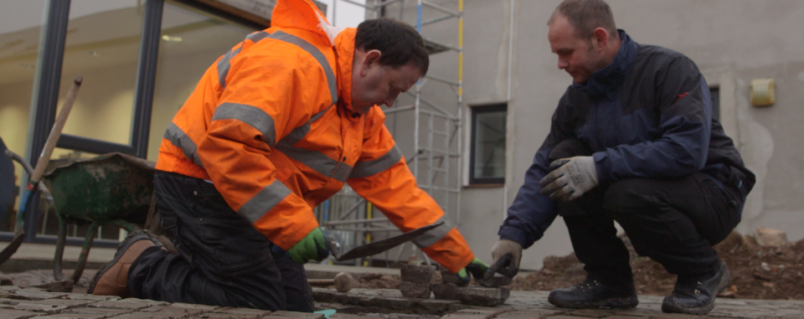
We are NatWest Social & Community Capital and we offer loans and support to brilliant social enterprises.
Social enterprises are businesses which are run for profit, but which use that profit to deliver a mission instead of paying it to shareholders.
We’re here to enable them to grow the social impact they make in their local communities.

Slide 3
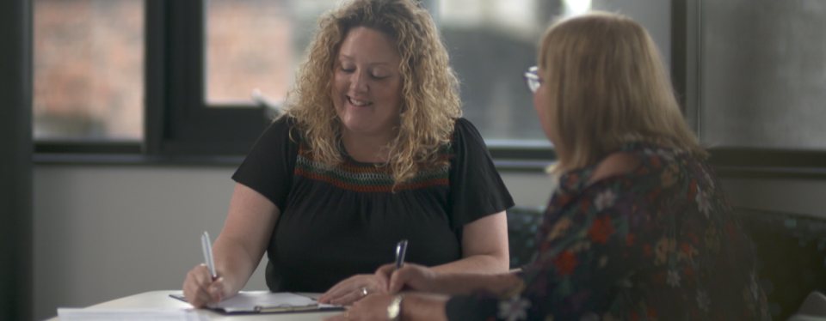
We’re an independent charity supported by the bank.
We were set up in 1999 to support community businesses that can’t access normal bank loans.
We combine financial expertise with social sector understanding to provide the lending and support social businesses need to reach further.

Slide 4

What makes an organisation eligible for a loan?
UK based
Financial Sustainability: Able to pay back a loan.
Social Impact: Demonstrating positive impact and reinvestment of profits for social purpose.
Suitable Governance: Well managed and governed.
Declined by a Bank: Not eligible for a mainstream bank loan.

Slide 5
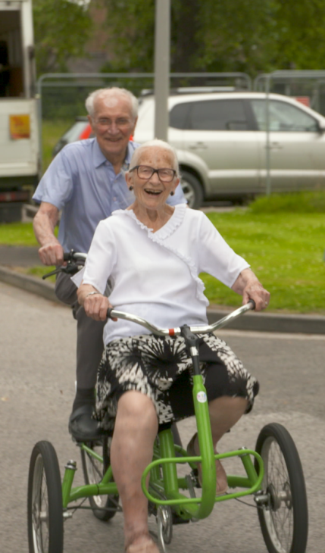
Our loans:
Between £30,000 and £750,000
Flexible terms
Added business support
Our Credit Panel
The Panel meet twice a month to assess loan applications, enabling organisations to apply year round and receive quick responses.
Made up of volunteers from both inside and outside the bank, they bring a wealth of expertise and experience from banking, business and social enterprise sectors.

Slide 6
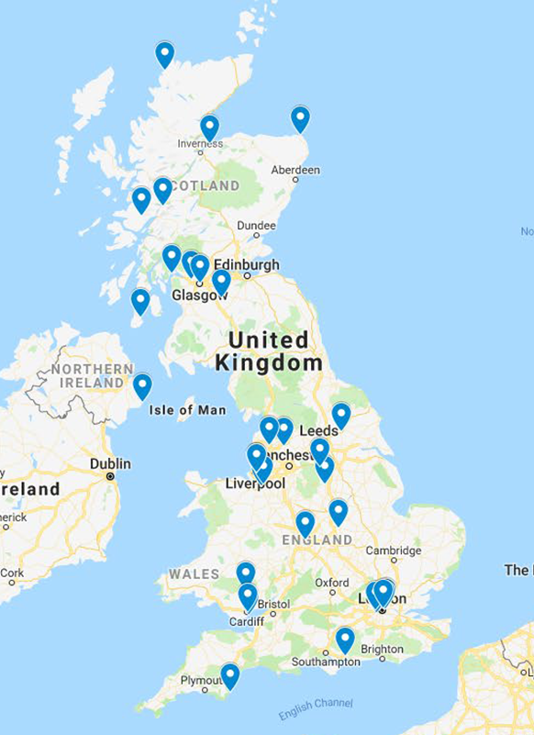
What our customers say about us:
“What an exceptional team; community focused with corporate skills and years of combined experience” Crisis Counselling, Erskine
“…an accessible, flexible and responsive package of support... There are plenty of providers out in the market place but none that can respond at pace, with clarity of information requests and followed by a timely decision outcome.” The Women’s Organisation, Liverpool
“We probably would have gone out of business without this loan” Harmony Community Trust, NI
“… the level of professionalism and understanding we received from everyone we had contacted with was really appreciated. The team were always at the end of a phone or available to visit and support at what was a very difficult time for us”. Disability Times Trust, London

Slide 7
Any questions?
@SocComCap
tracy.thomson@rbs.co.uk
natwestscc@natwest.com
natwest.com/scc

