Slide 1

Hampshire & Isle of Wight Community Foundation
Jacqui Scott
Chief Executive

Slide 2
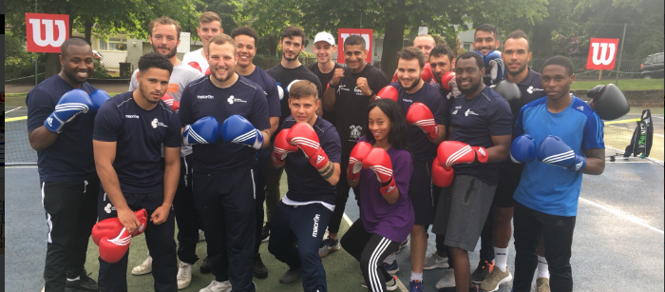
Our Vision
To help ease the burden of poverty for the most disadvantaged communities in Hampshire & Isle of Wight.

Slide 3
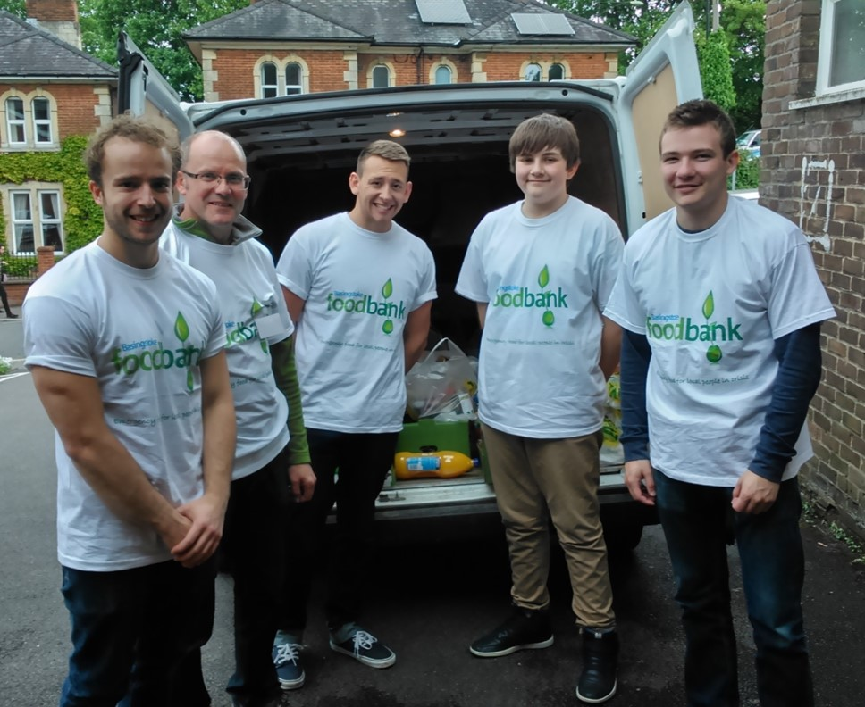
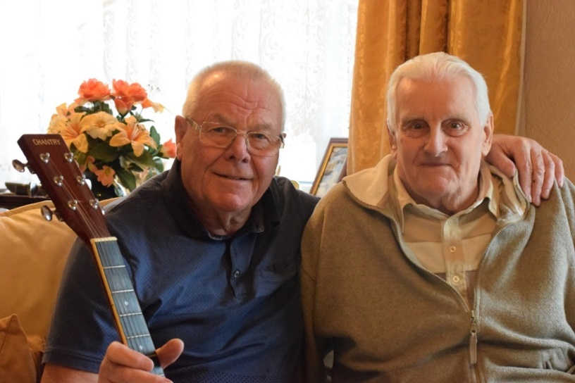
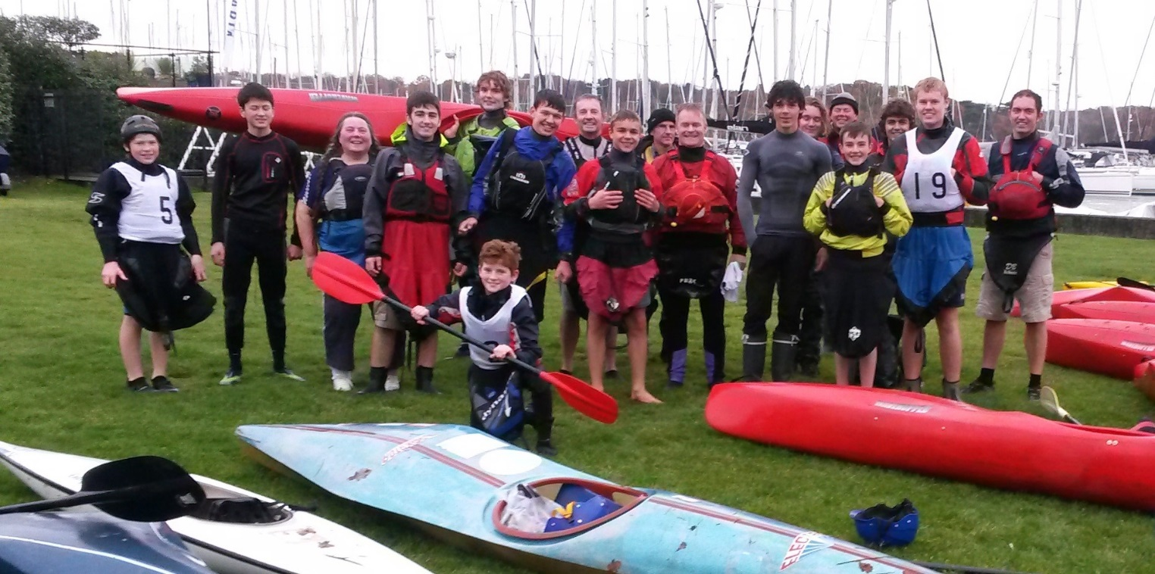
Our Mission
Is to provide a convenient and efficient service for donors wishing to make charitable contributions to their local communities; and to award grants with a special emphasis on supporting the smaller and less well known community and voluntary organisations working in the areas of greatest deprivation.

Slide 4
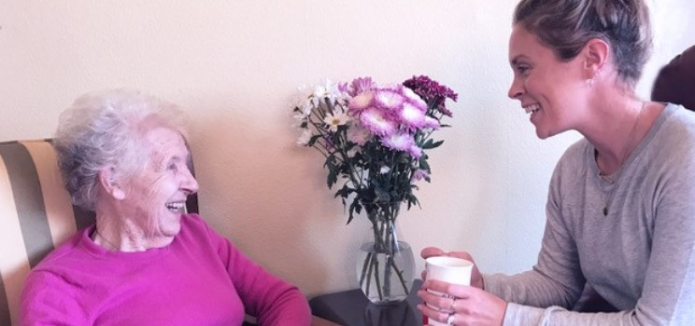

Overview of Community Foundations
Hampshire & Isle of Wight Community Foundation is one of a network of 47 active Community Foundations across the country supporting issues including: ‘Community & Family Support’, ‘Mental & Physical Health’ and ‘Poverty & Disadvantage’
In 2019/2020 UK Community Foundations combined had total investments of £700m, supporting 15,546 groups and 5,641 individuals, with an average grant of just under £5,000 being awarded.
Collectively the 4th largest philanthropic grant-maker in the UK
Supported over 20,000 voluntary and community groups nationwide

Slide 5

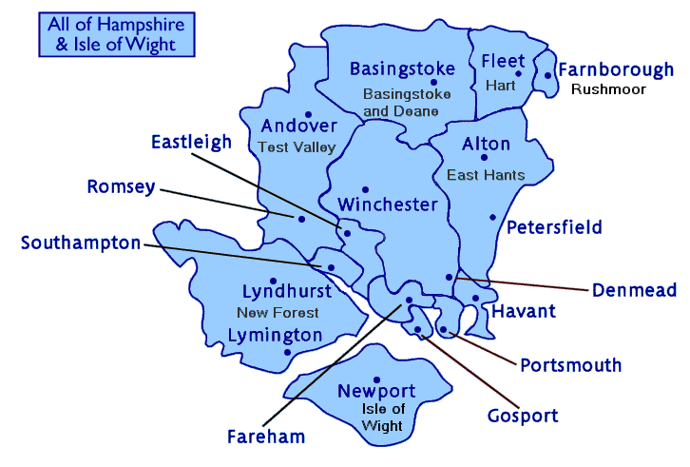
What is HIWCF?
Independent Charitable Foundation since 2002
Largest philanthropic grant maker across Hampshire and the Isle of Wight
“Local Giving for Local Needs”
Patron is the Lord-Lieutenant of Hampshire
Manage funds on behalf of local donors /
philanthropists and companies,
government/local authorities, EU,
Comic Relief and National Lottery

Slide 6
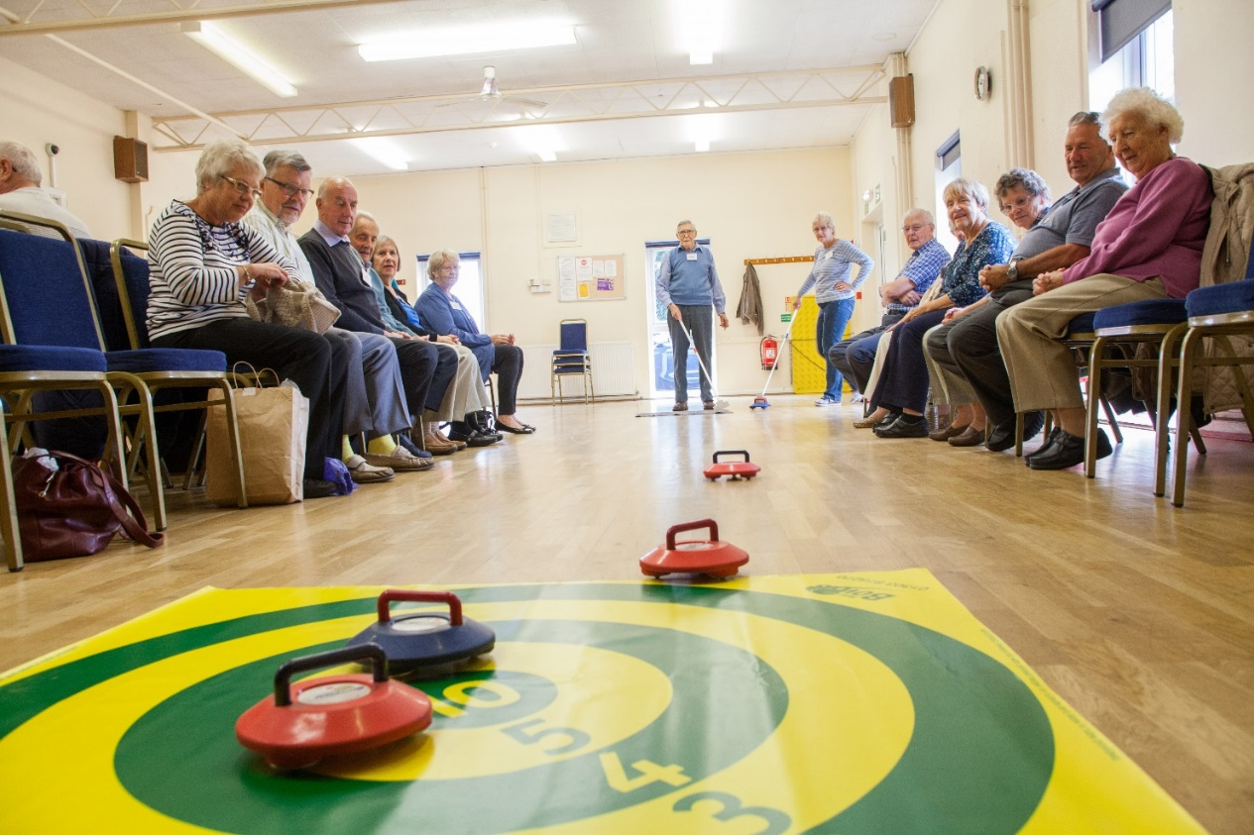
Our impact
We are committed to building funds and distributing grants to support small, local community projects:
We have distributed more than £13m in support of over 4,100 community projects to date. 1.5 million beneficiaries since we were formed
In 2020, awarded grants of over £2.3m

Slide 7
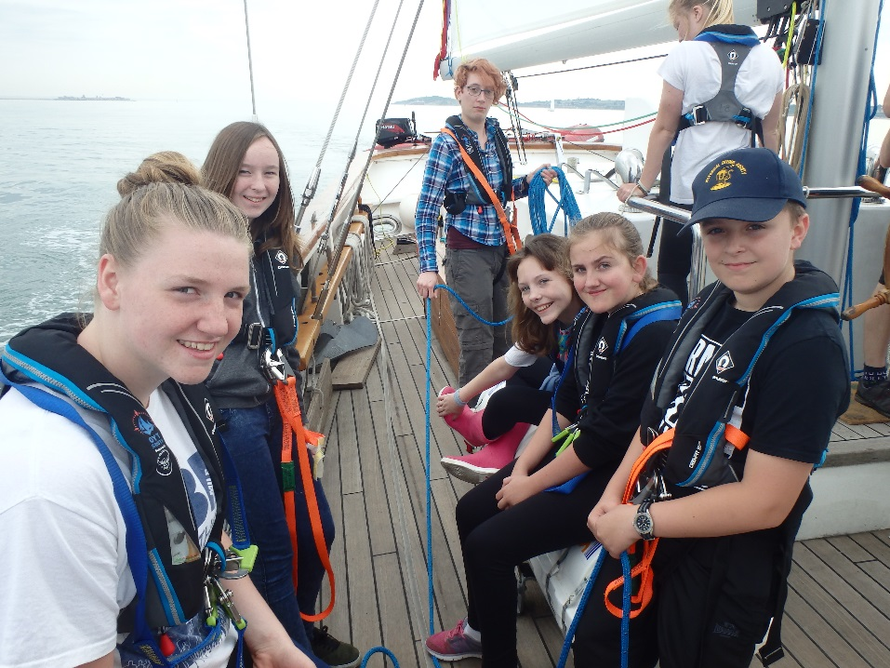
Issues Facing HIWCF
Hampshire and Isle of Wight have a population of 1.9m people
Wide variety of social demographics, income brackets, age profiles, historical context, coastal activity, urban development and rural & farming areas
H & IOW contains pockets of deprivation amongst the most severe in the country with 46 areas falling into the 10% most deprived areas in England, according to IMD data, with a further 68 areas falling into the 11% to 20% most deprived areas
There is a huge amount of unmet need and this is growing. In 2020, £4.7m of requests went unsupported. Which means we still have a lot to do to meet the ever-increasing need

Slide 8
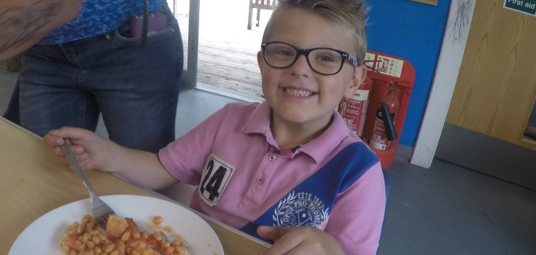
How we allocated our grants in 2020
Awarded grants totalling £2.3m
Supported 462 community projects and causes
Average grant size was £4,993 - up from £2,200
243 organisations new to HIWCF received grants (up from 92 in 2019)
Enormous HIWCF activity in response to enormous community response to COVID
…But £4.7m in unmet need

Slide 9
What are we doing to meet this need
Investing in fundraising and fund development
Reviewing grant applications over the past year and supplementing with independent research to understand needs to help inform our future priorities.
Working with growing range of organisations to ensure we are reaching new organisations and communities.
Reaching out to our communities in new ways (eg webinars) to ensure potential grantees have the knowledge and confidence to apply.
Looking at how we make criteria clearer for applicants.

Slide 10
Challenges and opportunities
Challenges
Emergency funding and furlough support is ending
Funding streams still prioritise the new and project based initiatives over core costs and services
Exacerbation of inequalities and rising need
Identifying emerging needs
Social impact of pandemic
Opportunities
Covid 19 prompted growth in philanthropy
Government experienced the strengths of the sector through pandemic response
Digital transformation
Funders discussions around flexible trust based funding
High level of community engagement

Slide 11
Current and upcoming funding streams
Our major funding programmes for 2021:
We’re All Together – complete
We’re All Together Strategic Themes – complete
Made By Sport – complete
Apply Now! - CLOSING 4th October 2021
Recovery Fund - £1-5K grants
Strategic Youth Recovery Fund - £12-15K grants

Slide 12
Current and upcoming funding streams
This year we are focussing on recovery. We know the sector has been hit hard and want to make sure we are able to support our local community by ensuring a thriving and diverse community and voluntary sector. We have two grant programmes currently open:
RECOVERY FUND
https://www.hiwcf.com/grant/recovery-fund/
up to £5,000
working with young people 16-25 yrs and/or older people over 65 yrs who have been negatively impacted by Covid
to help ease poverty, improve digital inclusion and to provide new skills to help improve opportunities for disadvantaged people
includes purchase of equipment, salaries, core costs, project costs, hire of meeting spaces, volunteer expenses and more.

Slide 13
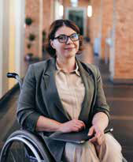
Current and upcoming funding streams
STRATEGIC YOUTH RECOVERY FUND
https://www.hiwcf.com/grant/strategic-youth-recovery/
grants of £12,000-£15,000.
for local voluntary and community organisations working with young people (16-25 years).
to help enable groups to rebuild their volunteer base to ensure greater sustainability and resilience for the future.
for organisations providing projects and services that offer new skills and opportunities.
collaborative project partnerships meeting the above criteria are also eligible to apply.

Slide 14
Current and upcoming funding streams
STANDARD EXCLUSIONS – WHAT WE CAN’T FUND
Grants that are solely for the provision of bursaries to individuals or families
Applications from individuals
Organisations NOT based and active in our funding areas of Hampshire including Portsmouth and Southampton, and Isle of Wight
National charities (except in cases where local branches can prove independence)
Capital building projects
Statutory bodies such as schools, city and county councils or health institutions
Organisations whose Objects are for the sole benefit or relief of animals or plants
Any party-political activity
Commercial ventures
Proselytising activities, i.e. active promotion of a specific religion or belief system

Slide 15
What we need from you when you apply for
Documentation – your constitution, accounts and bank statements, information about your finances and whether you generate income from your services, copies of specific polices like safeguarding etc
Clarity about what you do – in your own words: How are you changing lives? Do you use volunteers? How do you involve beneficiaries and their families’ in your work?
Clarity about what you want to use the grant for: tell us about the problem you are addressing, and how the grant could help fix that problem; tell us what the actual activities you have planned are and who / how many people will be involved
Information about your target beneficiaries and how you will reach them: tell us about how they are disadvantaged; the need they face; how you reach them; what age groups; what are their characteristics or background? How do you know they need the services you are offering?
Link what you are describing to us with the criteria we have stated.
Don’t assume we know anything!

Slide 16
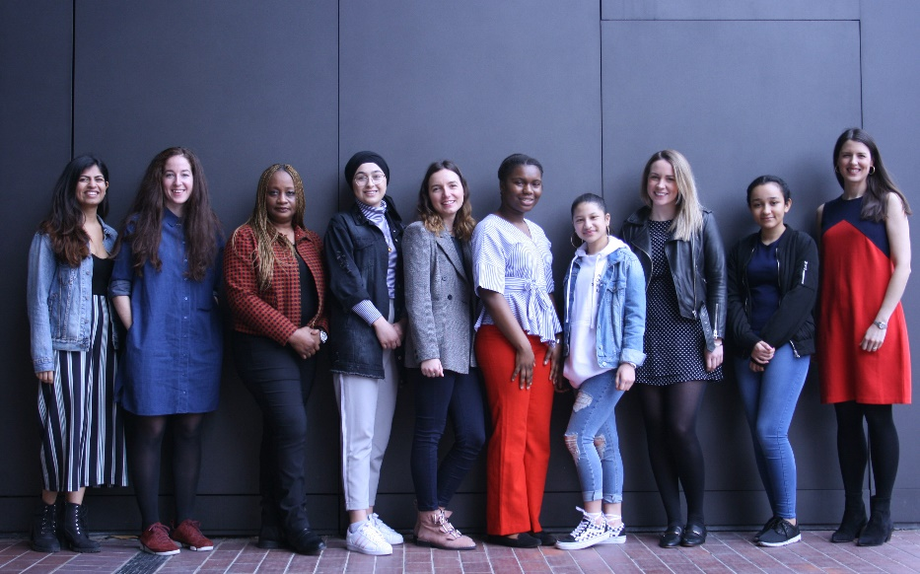
Our grant making process
Applications received by stated deadline
Reviewed internally for match to criteria
If you do not match criteria, you will be informed at this point
Those that match criteria are referred to external assessment
You may be contacted at this point
Grants panel is convened to review all proposals (depending on the fund, the panel is made up of HIWCF Trustees and / or Fundholders)
You are informed of the decision ASAP thereafter
Grants are paid normally within two weeks to a month of panel
Overall process from submitting application to receiving a grant can be around 3 months

Slide 17
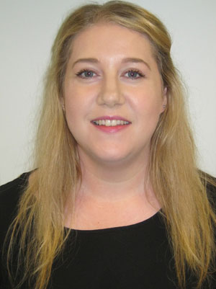
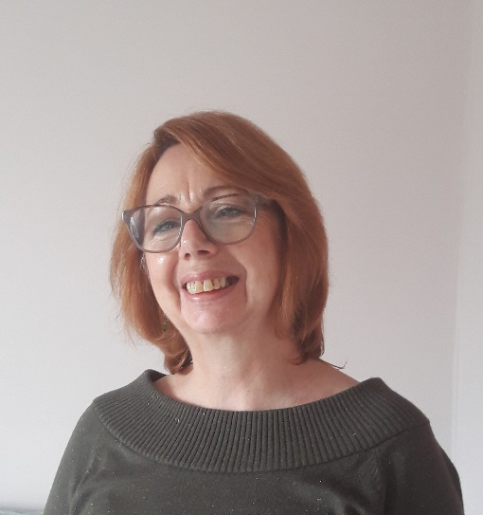
If in doubt – Shout!
We have a tiny grants team but WILL help when you are shaping up your application. We know funding proposals can be challenging and we want to make it as easy for you as possible.
Please call us on 01962 798693
Or email on Grantsadmin@hiwcf.com

Slide 18
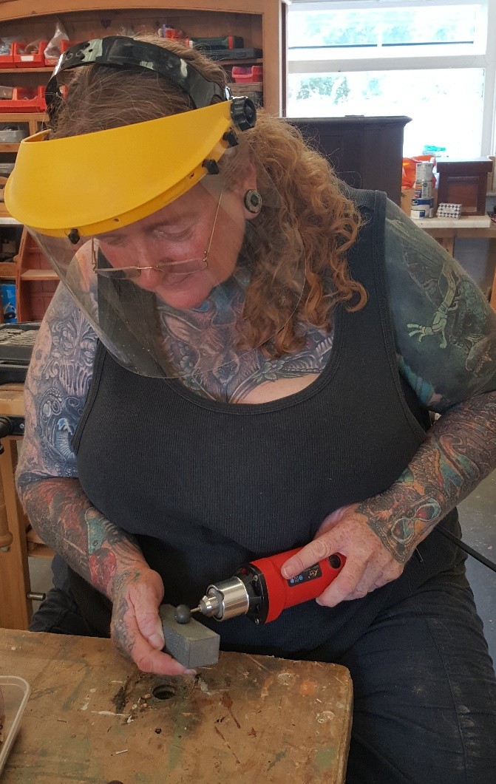
What we need after you receive a grant…
Monitoring – we will ask you to complete a fairly straightforward monitoring form. We provide the form when we give the grant. Completion normally required within 12 months of the grant.
Case studies – we encourage grant recipients to help support us by providing us with case studies (with appropriate consents) to use in our marketing materials. Please share social media content with us!
And if there are problems along the way – please talk to us. We understand that things don’t go to plan, but we would like to know about it sooner rather than later!

Slide 19
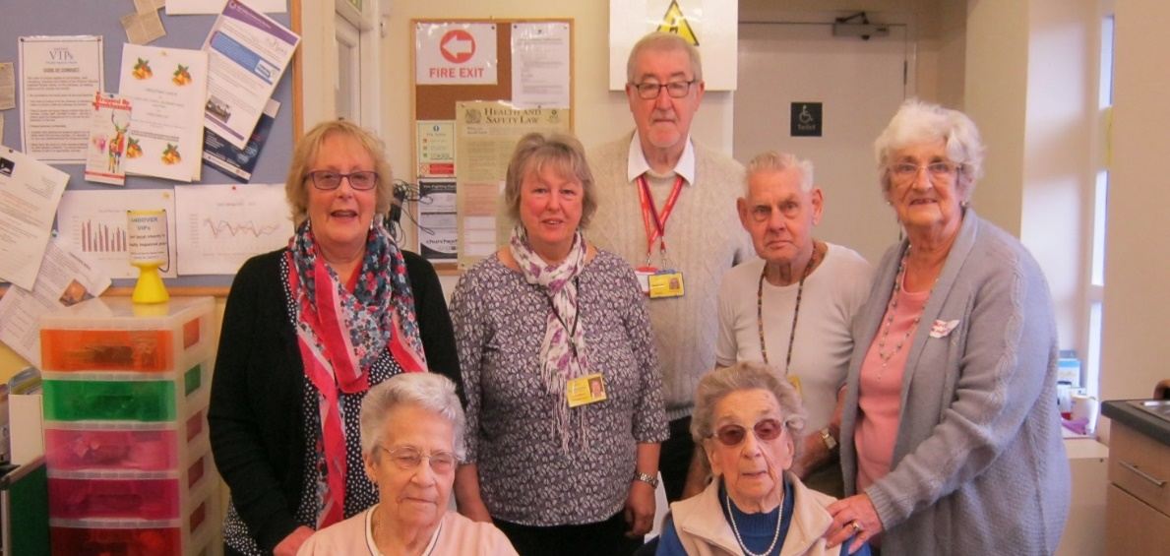
Follow us!
Other (smaller) funds will become available throughout the year – all are advertised here www.hiwcf.com/grants/
To receive HIWCF emailings for grants updates, please complete www.surveymonkey.co.uk/r/DPBPRMN
Follow and like @HIWCF on twitter and Facebook, and we will also share and like yours.
Sign up to the Action Hampshire newsletter here: https://actionhampshire.org/about-us/ - a weekly bulletin detailing all new programmes in the area.

Slide 20
Thank You
For further information please contact:
Jacqui Scott
Chief Executive
Hampshire and Isle of Wight Community Foundation ceo@hiwcf.com
Or our grants team on grantsadmin@hiwcf.com

