Slide 1


Frimley Clinical Commission Group
Our approach to Community Engagement
Wednesday 15th September
Steve Manley
Head of Engagement
Nisha Duggal
Communications and
Engagement Manager

Slide 2

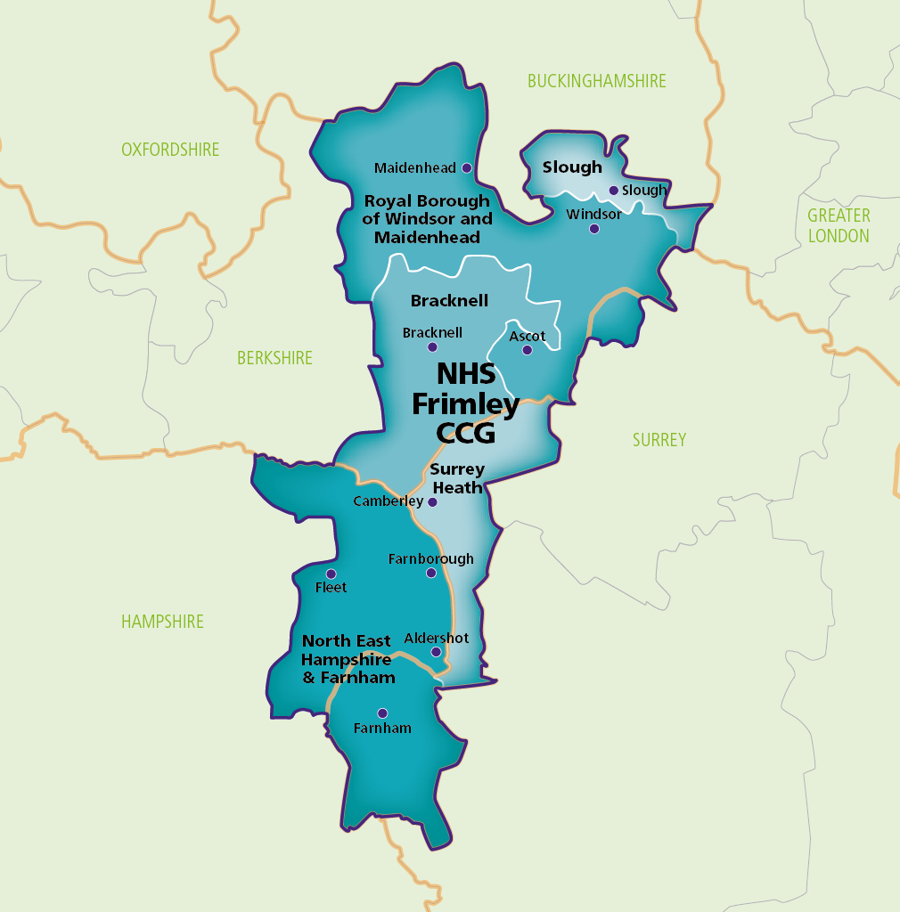
Becoming Frimley CCG
Bracknell Forest
North East Hampshire and Farnham
Royal Borough of Windsor and Maidenhead
Slough
Surrey Heath
From April 2022:
Frimley Health and Care
Integrated Care System (ICS)

Slide 3
'Join the conversation' to understand and involve people and communities in all that we do
What we're aiming for
Why we believe in this
Meaningful, consistent and timely involvement with local people and communities. Ensuring equality, diversity and inclusion is at the heart of thinking, planning and delivery.
Working in partnership with patients, carers, families and local people within their own communities brings a different perspective to our understanding and can challenge our view of how we think services are received and should be delivered in the future.

Slide 4

ICSs must listen consistently to, and collectively act on, the experience and aspirations of local people and communities. This includes supporting people to sustain and improve their health and wellbeing, as well as involving people and communities in developing plans and priorities, and continually improving services.
ICS Design Framework, NHS England, June 2021

Slide 5
The new Integrated Care System (ICS) Design Framework sets out seven principles for working with people and communities:
Use public engagement and insight to inform decision-making
Redesign models of care and tackle system priorities in partnership with staff, people who use care and support and unpaid carers
Work with Healthwatch and the voluntary, community and social enterprise sector as key transformation partners
Understand your community’s experience and aspirations for health and care
Reach out to excluded groups, especially those affected by inequalities
Provide clear and accessible public information about vision, plans and progress to build understanding and trust
Use community development approaches that empower people and communities, making connections to social action.

Slide 6











Community
Deal
For people and communities
Our ambition is to build a different relationship with our communities and residents, harnessing existing strengths, together with services, to find solutions
Community
Forums & AGM
I&I Portal
Discover opportunities for involvement and share insight on a wide range of issues
Our Community Forums and AGM offer the public the opportunity to hear about our work and influence health and care priorities together
Innovation Funding
Our Governing Body meet in public at least three times a year. They provide an opportunity to ask questions and hear directly from our system leaders
Governing Body meetings in public
Our Innovation Fund gives local people and organisations the chance to receive support and funding for new ideas and projects that can support health and wellbeing in our communities
Volunteering opportunities
A wide range of volunteering placements are available across the system, whether this is directly with us or with one of the many voluntary sector partners across our area, we can help connect people to local volunteering opportunities

Slide 7

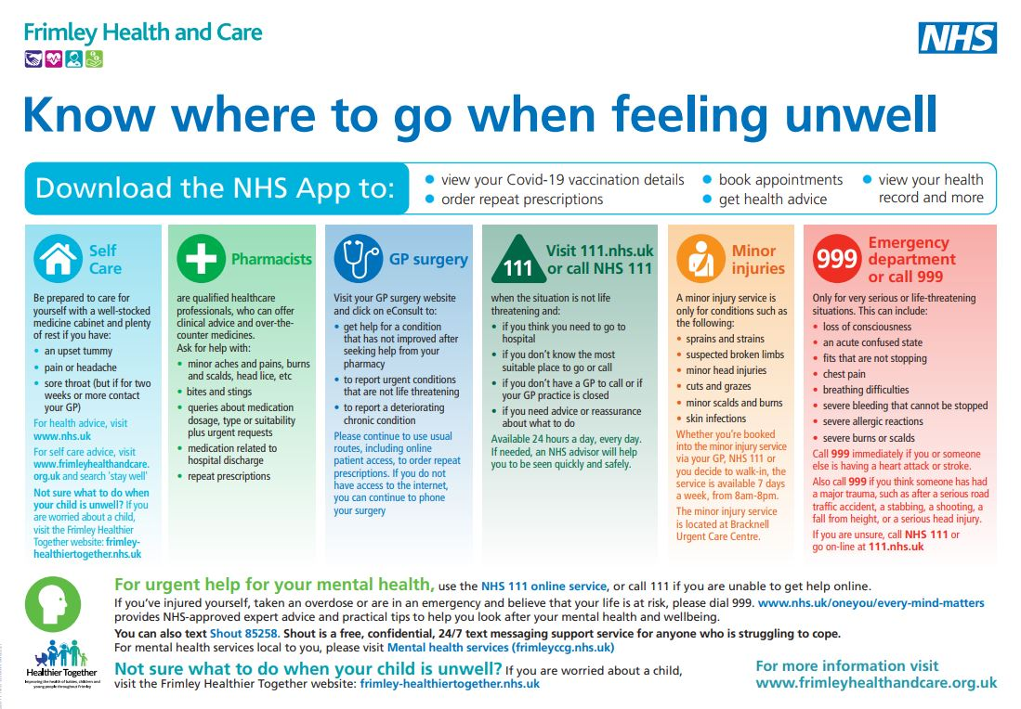

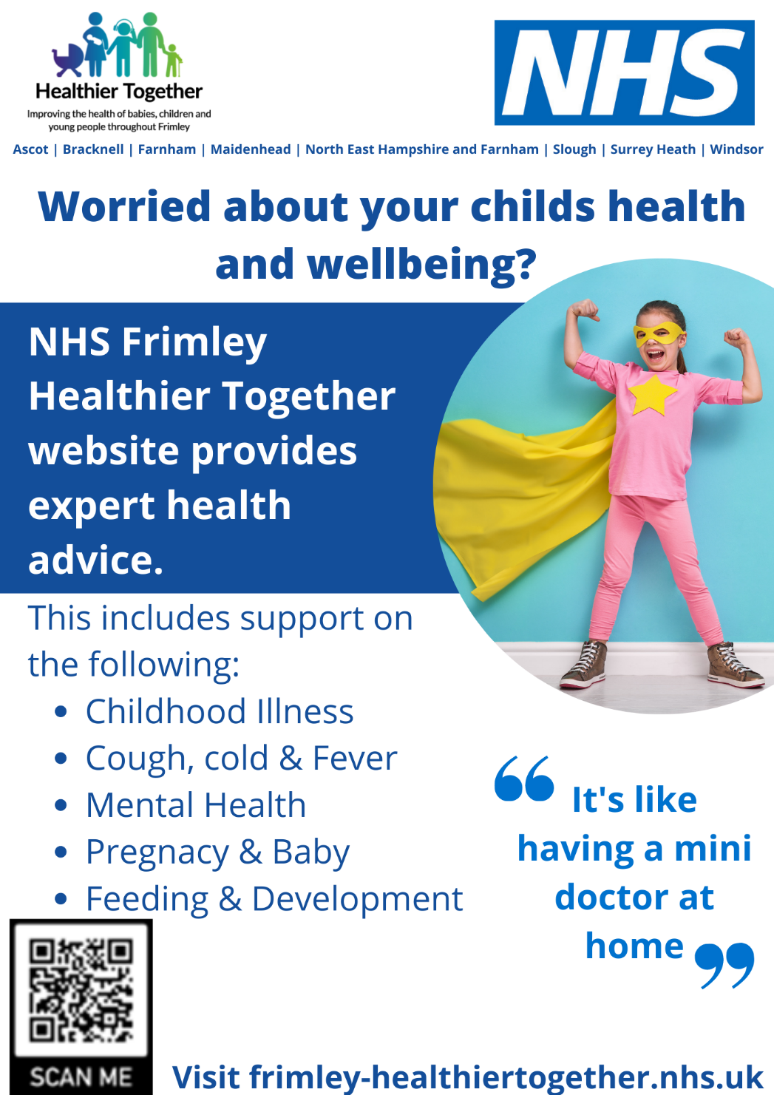
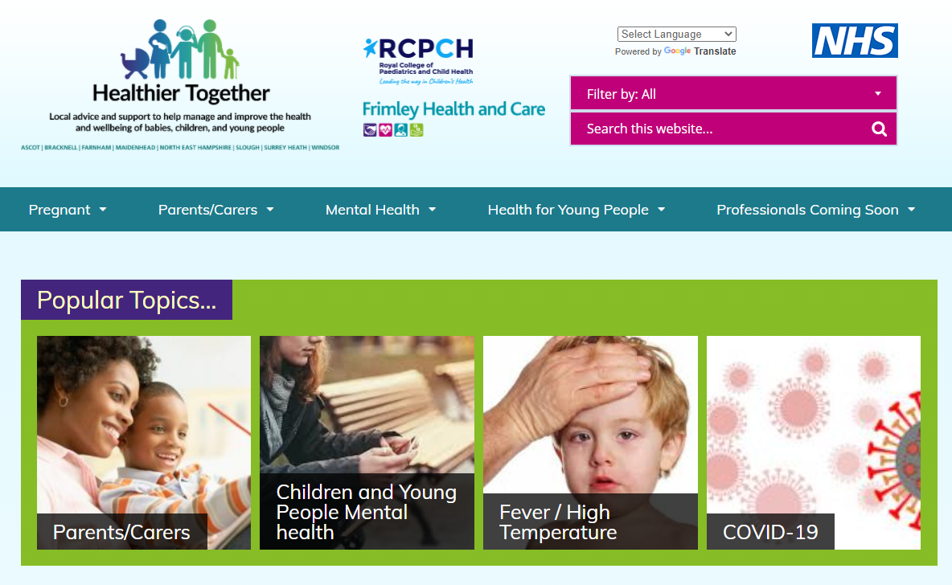

We need your support

Slide 8



@FrimleyHealthandCare
@NHSFrimleyCCG
@FrimleyHC
@Frimley_CCG
Visit our websites:
www.frimleyhealthandcare.org.uk
www.frimleyccg.nhs.uk
@NHSFrimleyCCG

Slide 9
Join us for our AGM – 21 September
Be part of the conversation at our virtual AGM
Opportunity to hear all about our achievements and the challenges we have faced
Hear about:
Our response to the pandemic and vaccine roll out
The Community Deal - including our Innovation Fund
Our system journey
Register via Eventbrite: https://www.eventbrite.co.uk/e/frimley-clinical-commissioning-group-annual-general-meeting-tickets-166637656717

Slide 10

Questions

