Slide 1

Community
Leah Campbell
15 September 2021

Slide 2

Background
10 years humanitarian sector
Led research & engagement work to improve learning at ALNAP
Sharing examples from that work

Slide 3
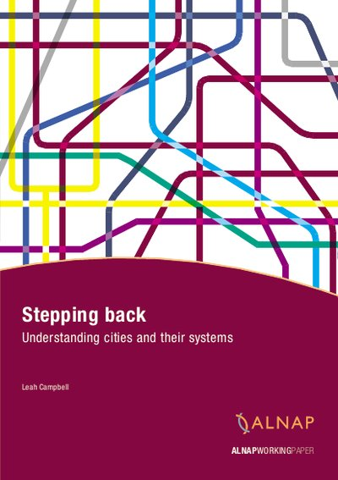
What is Community?
Urban vs Rural
Community not as simple as geography
People belong to multiple communities

Slide 4

6 Types of Communities (Nabeel Hamdi)
1. Communities of place: common spatial connection
2. Communities of interest: formed around a common issue/concern
3. Communities of resistance: shared experience of crisis/displacement
4. Communities of culture: shared language, beliefs, values
5. Communities of practice: common livelihoods
6. Virtual/digitised communities: connected through new media

Slide 5
Community Engagement or Community Development?

Slide 6

The Engagement Arrow
Development
Level of engagement
Participation
Two-way communication
Ownership
Accountability
Consultation
Information provision
Modalities of engagement

Slide 7
Reasons for Engaging
Normative/value-based
Instrumental
Emancipatory
BUT many organisations are not clear about WHY they are engaging

Slide 8
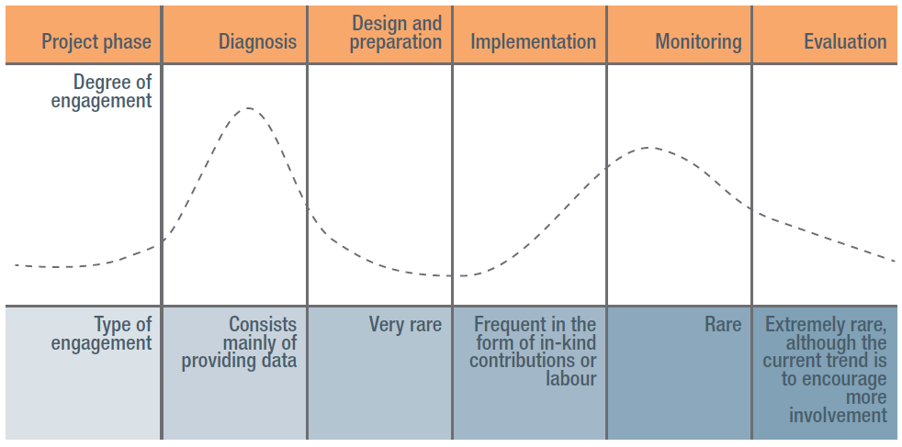
Engagement through Project Cycle

Slide 9
Constraints to Engagement
Cost
Access
Skills
Attitudes and Behaviours
Turnover
Projectisation
Supply-led paradigm
Lack of political will
Power imbalances

Slide 10
Engagement vs Development
Community Engagement INVOLVES the community
Community Development is LED BY the community
What are we aiming for?
What are we achieving?

Slide 11

Questions

Slide 12
Keep in Touch
Leah Campbell
L.Campbell@actionhampshire.org

