Slide 1
The Grub Hub

Slide 2

February Half Term Food Larder

Slide 3
Food Larder Usage over 5 days
 | Ward | Households | Adults | Children | Total | Singles
 | Aldershot Park | 14 | 24 | 10 | 34 | 4
 | Manor Park | 10 | 20 | 16 | 36 | 1
 | North Town | 12 | 20 | 19 | 39 | 2
 | Rowhill | 6 | 11 | 8 | 19
 | Wellington | 12 | 24 | 23 | 47 | 1
 | Empress | 2 | 5 | 5 | 10
 | Ash/Tongham | 3 | 6 | 0 | 6 | 0
 | Heath End/Hale | 2 | 2 | 2 | 4 | 1
 | Badshot Lea | 10 | 33 | 40 | 73 | 1
 | Other Waverley | 5 | 9 | 18 | 27 | 1
 | Other | 3 | 5 | 2 |  | 1
 | Totals | 79 | 159 | 143 | 295 | 11

Slide 4
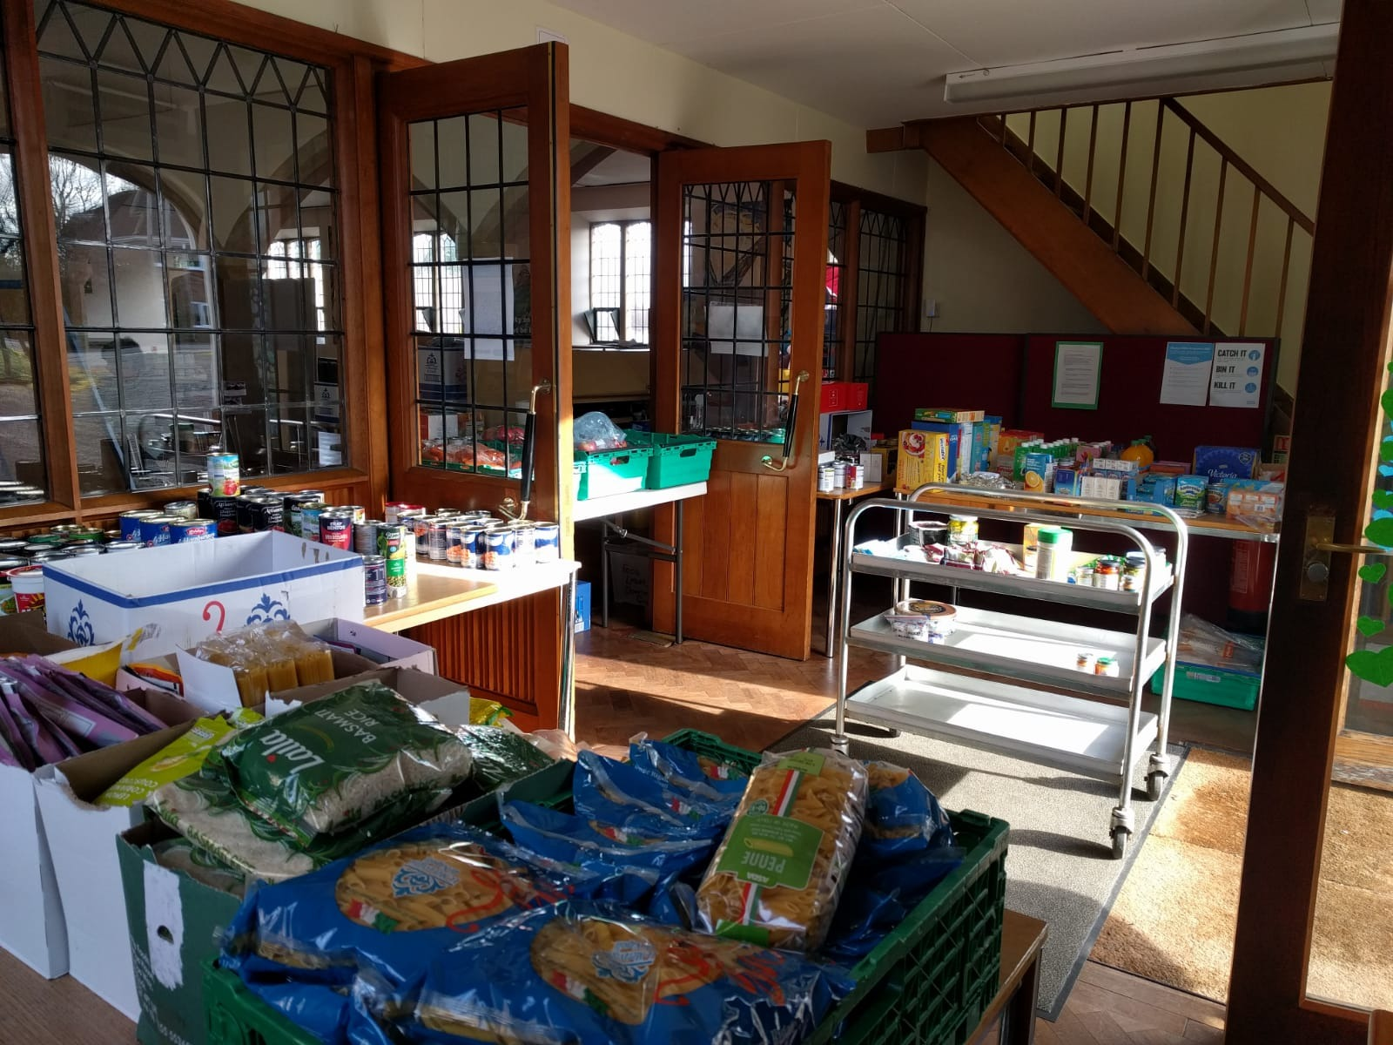

Slide 5
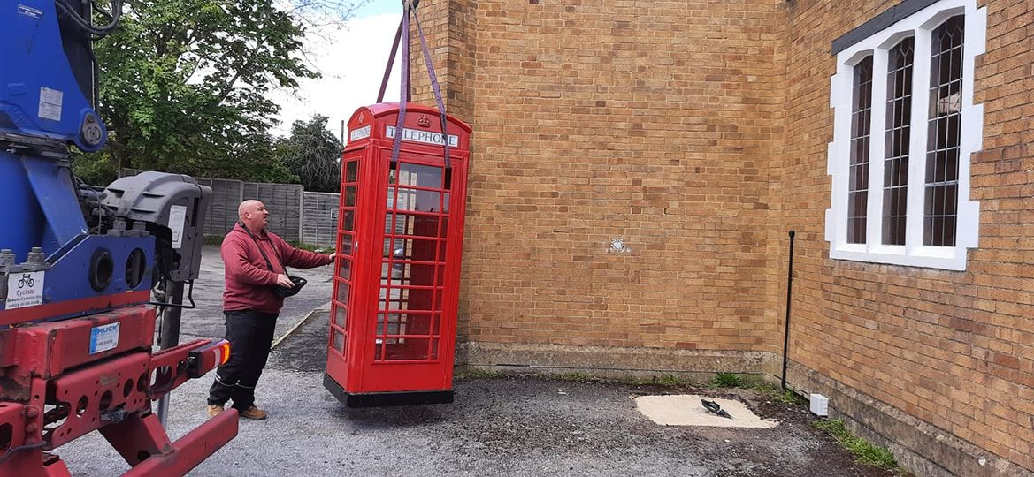
Phone Box Food Larder

Slide 6
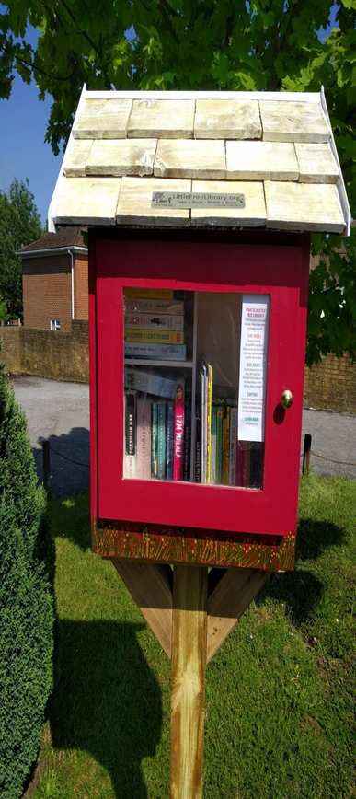
How it works – Little Free Library

Slide 7
Grub Hub Next Steps

Slide 8
Waiting on CIO status approval
3 Trustees – aiming for 6-8
RVS holding temporary lease
Bank account etc. waiting on CIO
Recruiting a short term project manager for set up phase – 6 months
When operating shop style – part time manager plus volunteer team
Additional support services to be available – including community wardrobe
Long term sustainability through grants and partnerships
Aim to have satellite larders in Aldershot , Farnborough and North Camp.

