Slide 1

June 2021

Slide 2
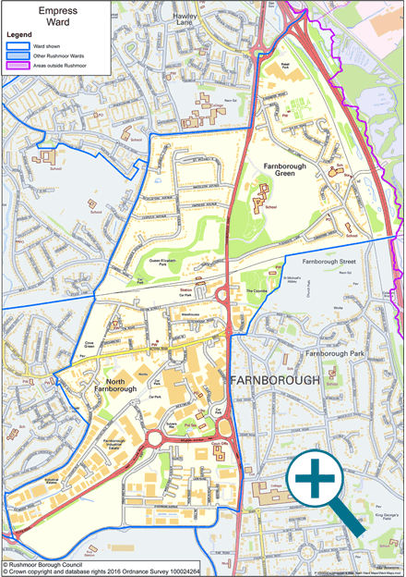
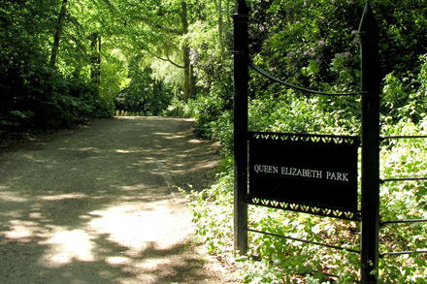
Where is Queen Elizabeth Park?
A 24-acre woodland park popular with dog walkers, joggers and cyclists. Ideal for local families to enjoy the natural setting.
The Park was once part of the Farnborough Hill estate, and formerly, the outer reaches of the Royal Windsor Great Park.
Now surrounded by houses, a mainline railway and busy roads, it offers a tranquil oasis and a haven for wildlife. It shows the changes in the seasons as demonstrated by the wealth of mature tree species present.
Opposite the playground there is a temporary pond (wet and dry depending on weather), which provides a habitat for very specific species adapted to such conditions. This pond is a valuable asset in its own right and needs to be protected.

Slide 3

Friends of Queen Elizabeth Park
(Constitution - established June 2020)
Its aims: To help ensure Queen Elizabeth Park, Farnborough, GU14 8NY is a well-maintained and safe public site which can enhance the quality of life for local people by improving their physical and mental health and act as a focus for bringing people together. To protect the park itself and ensure that it provides a safe habitat for wildlife and remains connected to the local green infrastructure.
Purposes:
i) find out the views of local people and park users
involve park users and local people in planning, decision-making and all aspects of management including environmental management affecting Queen Elizabeth Park, and specific facilities within the site (i.e. pond, play areas and sitting areas).
raise funding to maintain and increase the facilities on the site (including educational facilities)
develop relevant and beneficial partnerships with Rushmoor Borough Council and other environmental bodies
encourage people, from all sections of the community, to use the park and to enjoy its full potential and promote an atmosphere of mutual appreciation and respect for the natural environment
encourage users, including ourselves, to organise appropriate public social activities at the park
link with other similar local groups to help protect and improve green open spaces.

Slide 4
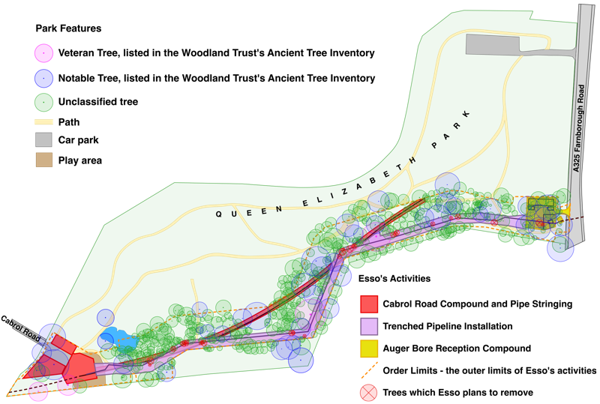
What have we been doing in the last few years to protect this valuable woodland environment? Spring 2019 until now.
The threat from Esso (old plan below).
Facts and figures –
Attended all the Planning Inspectorate’s examination meetings and presented.
Nick and Marion Jarman wrote ten extremely detailed papers which totalled 260 pages.
8074 individuals signed our petition
Undertook detailed footfall surveys
Registered every significant tree on the ‘Ancient tree directory’ with Woodland Trust.

Slide 5
What did we do last year - 2020-2021?
Free membership – built from 0 in June 20, 75 in Jan 21 and now 98 in June 21 (listing their interests and potential help).
727 followers on Facebook – biggest post reaching over 2200 people
Activities – Bat Walks, Litter Picking (102bags) and Seasonal Photo Competitions
Successful Grant Applications
Shed, new equipment purchased, first aiders trained ready for working parties
Media presence – 7 press articles, 3 local paper front covers, Eagle Radio, Local BBC TV articles, Arena magazine.

Slide 6
Next year – continue to grow and flourish
Ecological and actual mapping of what we have in the park (was to have been in April 2021). Brambles……Bats and Bluebells
More communication with those using the park – what they want to see happen.
Working Parties – to commence we hope in August 2021 in zones.
Further Funding Applications for noticeboards and trails etc
QEP – Jubilee Year 2022 – 4 days of community events – initial plan ….want further help to develop.

Slide 7
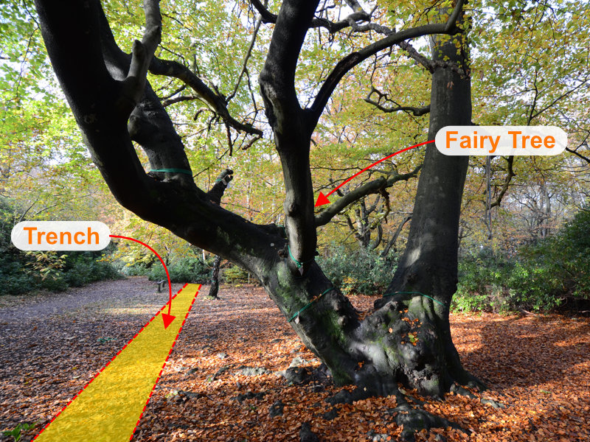
Breaking News ….your help needed - Esso’s final plans please visit https://www.queenelizabethpark.net/ - see how you can help us – this week.
Esso now want to dig their pipeline trench further from the path, closer to the trees. This puts our trees at greater risk. The Fairy Tree is more endangered than ever before because the trench is much closer to its trunk. Two metres closer.
We have asked them to change their working area in the park, but they have refused.
We said Esso’s plans for installing the pipeline under the A325 were unworkable. We were right. Esso has now scrapped those plans and adopted the method we said would work: Horizontal Directional Drilling (HDD).
We still want Esso to use HDD throughout the park, not just to cross the A325. This means there is no need for a trench and the trees would be safe.

